Slide 1

BOARD FOR RESEARCH EDUCATION
AND DEVELOPMENT
(BREAD)
A – 262, Sector – 19, Noida, U P, India - 201301

Slide 2
VISION
Empowerment Through
Education

Slide 3
SHANTY P K
(Member)
MARY CHERIAN
(Treasurer)
CHAIR PERSON FR. PROVINCIAL DP OF IMS
GEORGE OPARATAS (Member)
FRANCIS K.J
(Secretary)
JOSON
THARAKAN JOHN
(Managing Trustee)

Slide 4
BREAD
MARY’S MEALS
MOTHER’S CARE
BLOSSOMS
MOTHER’S LEAP
Food
Educational Assistance
Future Education
Job oriented training

Slide 5
Total no. of Beneficiaries – 20954 under
mary’s meals: 20387
Mother’s Care - 2009
Blossom - 300
Mother’s Leap - 23

Slide 6




mary’s meals feeding - Statewise
Delhi
RJ
UP
BR
MP
WB
JK
UP – Uttar Pradesh
BR – Bihar
RJ – Rajasthan
OD – Odisha
MP – Madhya Pradesh
CG – Chattisgrah
JH – Jharkhand
WB – West Bengal
CG
ODI
Calcutta
Mumbai
Chennai
(Madras)

Slide 7
MARY’S MEALS CHILDREN STATEWISE – 2017 - 18

Slide 8
THE GROWTH OF MARY’S MEALS IN INDIA

Slide 9
BREAD WITH LOCAL PARTNERS AND NO. OF CENTERS – 2017-18
TOTAL CENTERS - 58

Slide 10
BREAD WITH LOCAL PARTNERS AND NO. OF CHILDREN – 2017-18
TOTAL PARTNERS – 15
BREAD OFFICE - 2

Slide 11
TYPE OF SCHOOLS/ CENTERS
DATA OF 2017-18
TOTAL NO OF M.M CENTERS/SCHOOLS :58

Slide 12
GENDER CLASSIFICATION

Slide 13
Category of mary’s meals children

Slide 14
Level Of Education

Slide 15
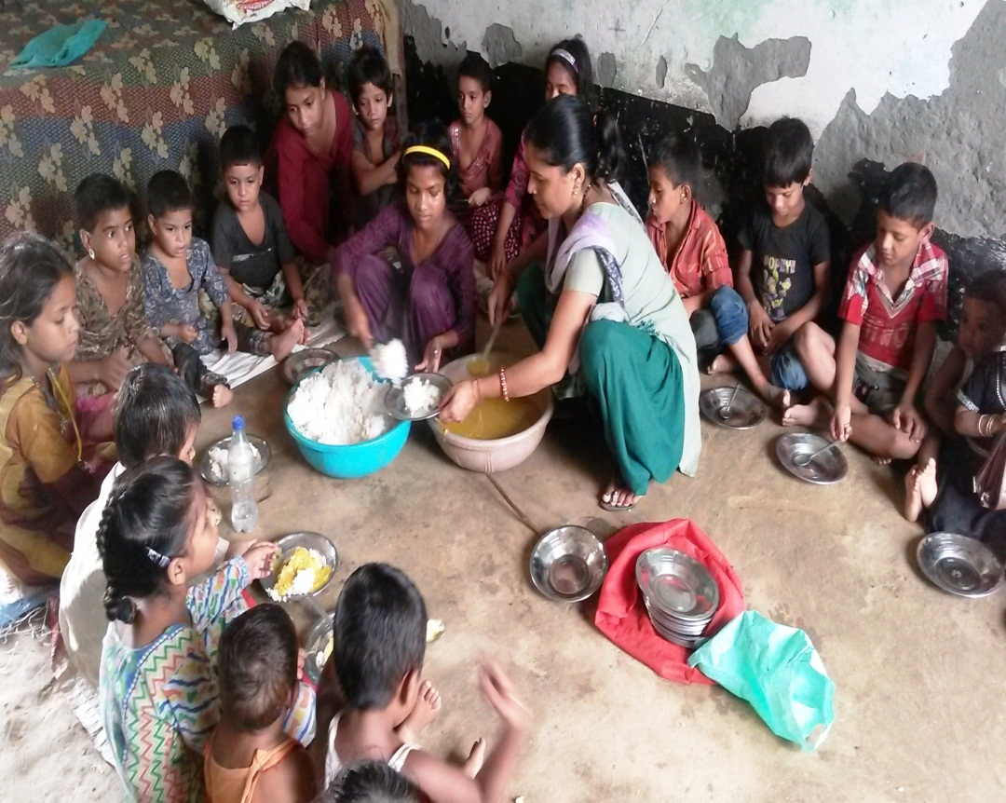
Why feeding :
WE BELIEVE
1. Food & Education is key to development and alleviation of poverty.
2. Food, serves as an incentive to the hungry children to come to the classroom

Slide 16
Fruits of mary’s meals
Nutritious food for the poor children
Improvement in health status
Children re- discover their childhood
Community participation
Gender discrimination is reduced
Child labour reduced
Improvement in educational conditions
Education among girl children is promoted
Caste imbalance reduced as children eat together

Slide 17
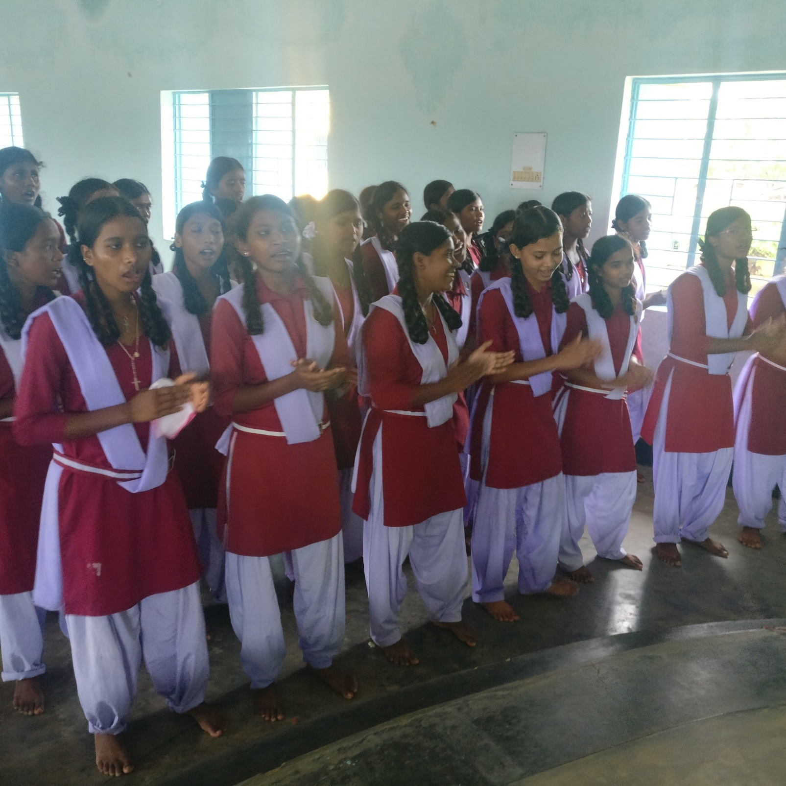

Slide 18
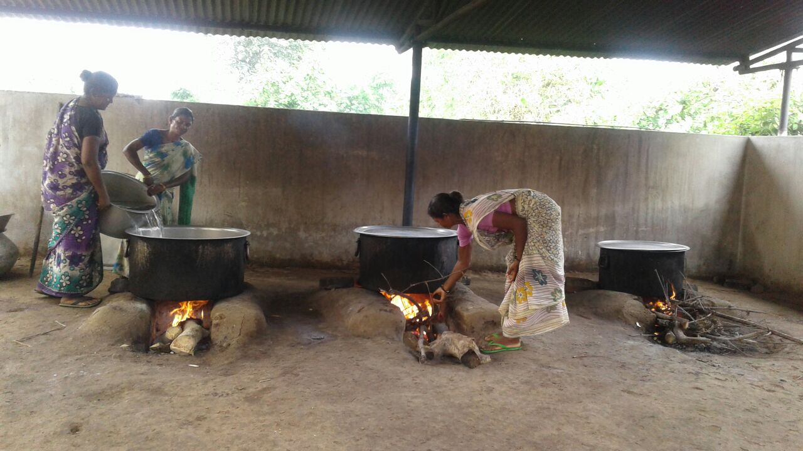

Slide 19
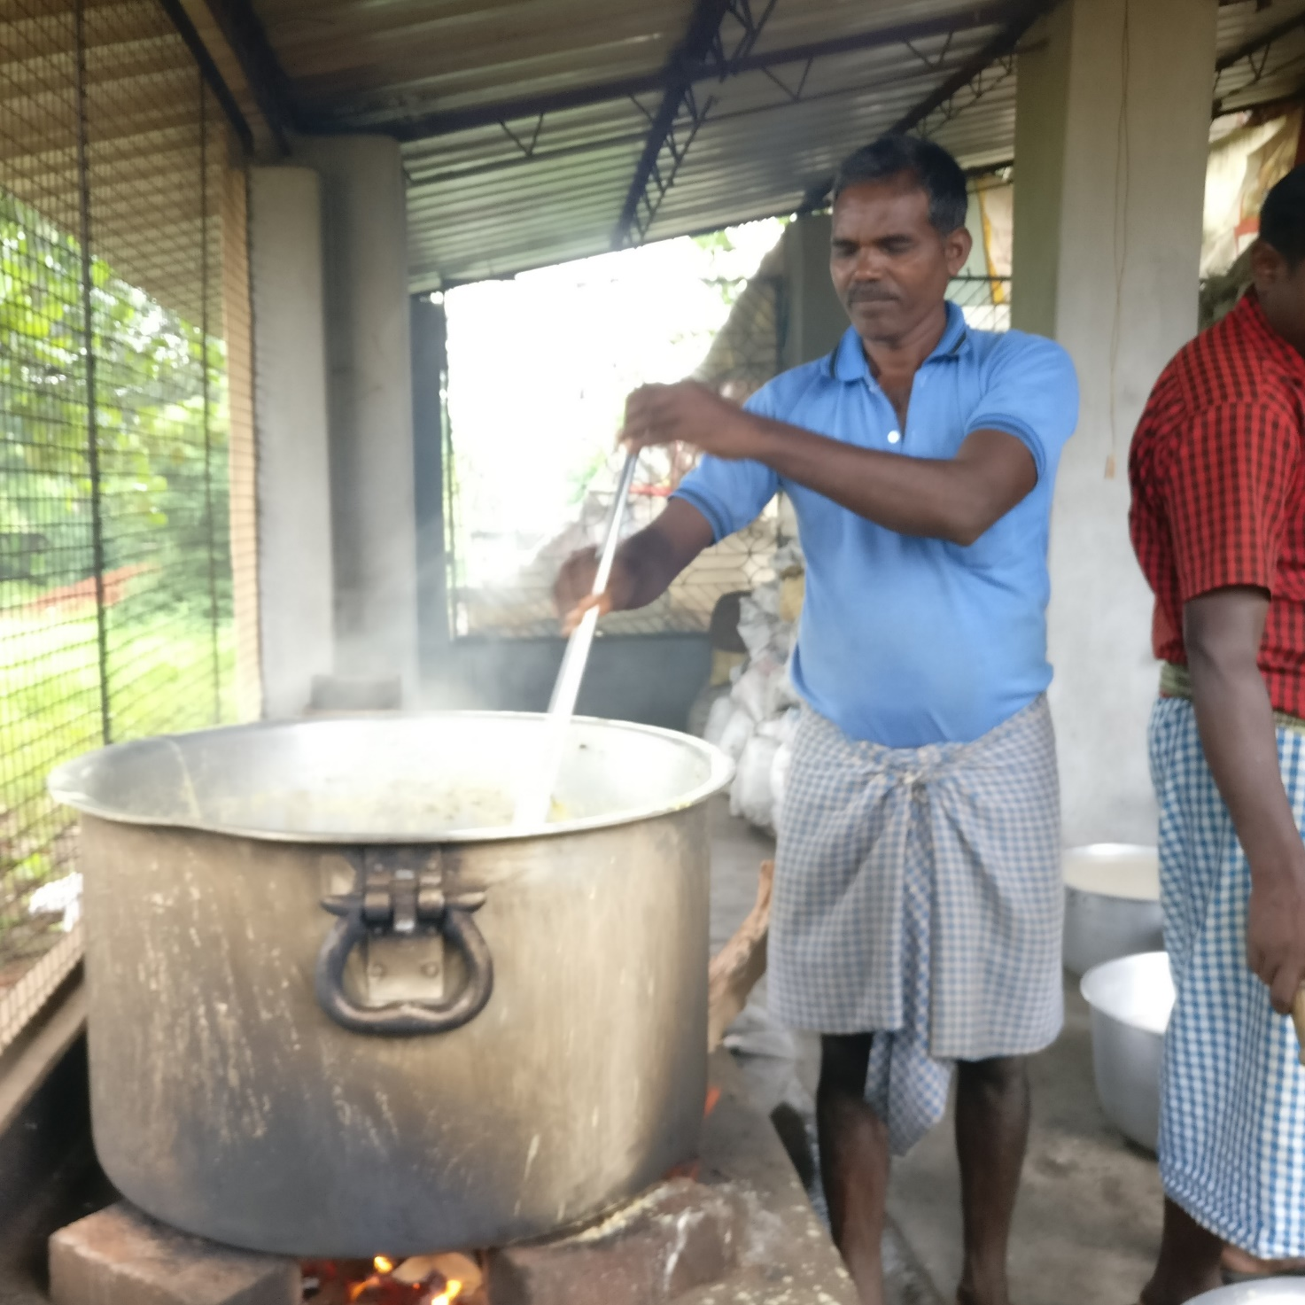

Slide 20
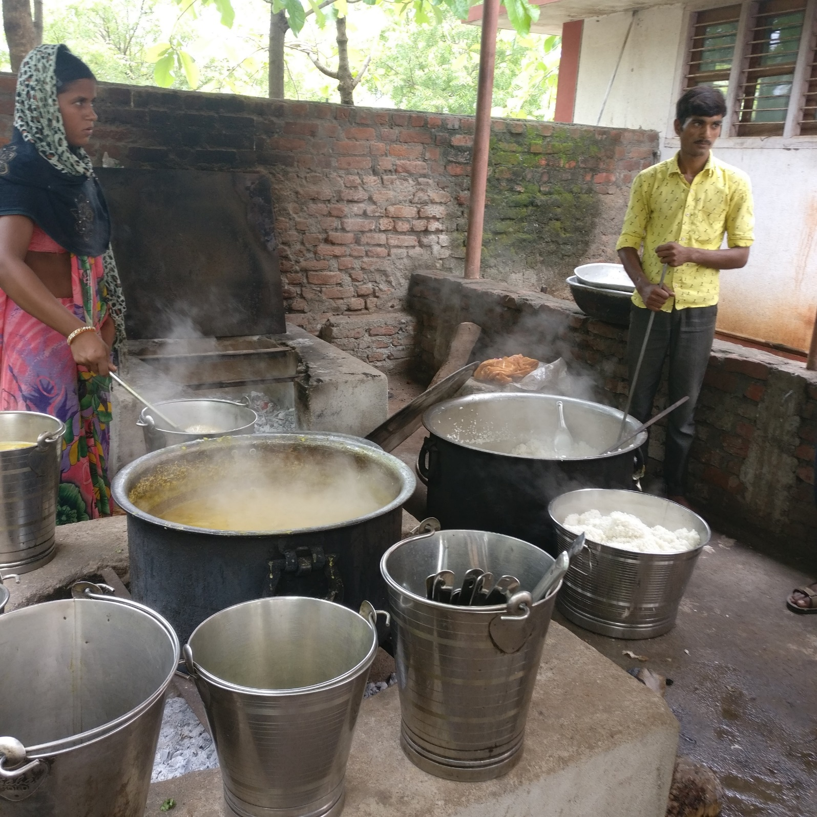

Slide 21
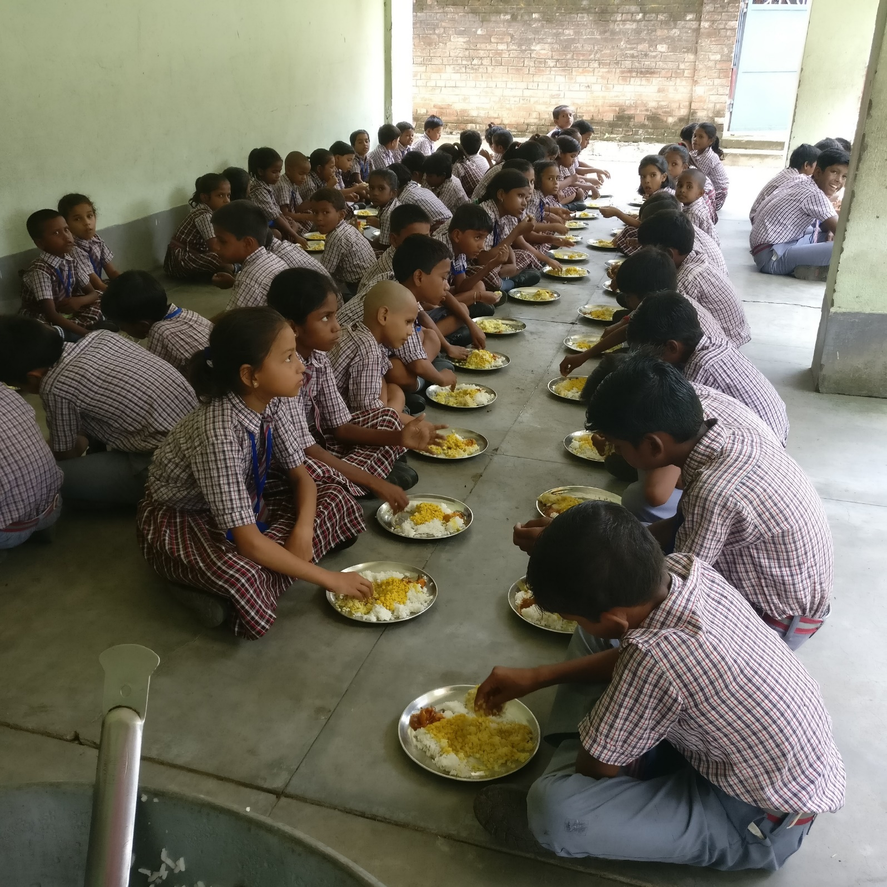

Slide 22
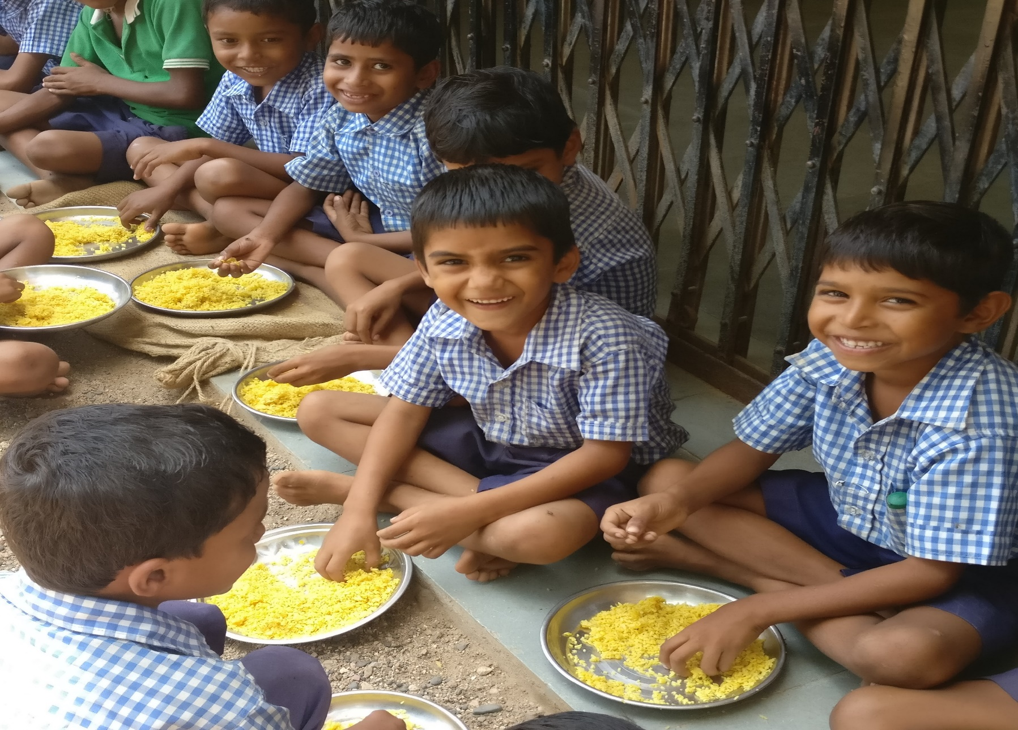

Slide 23
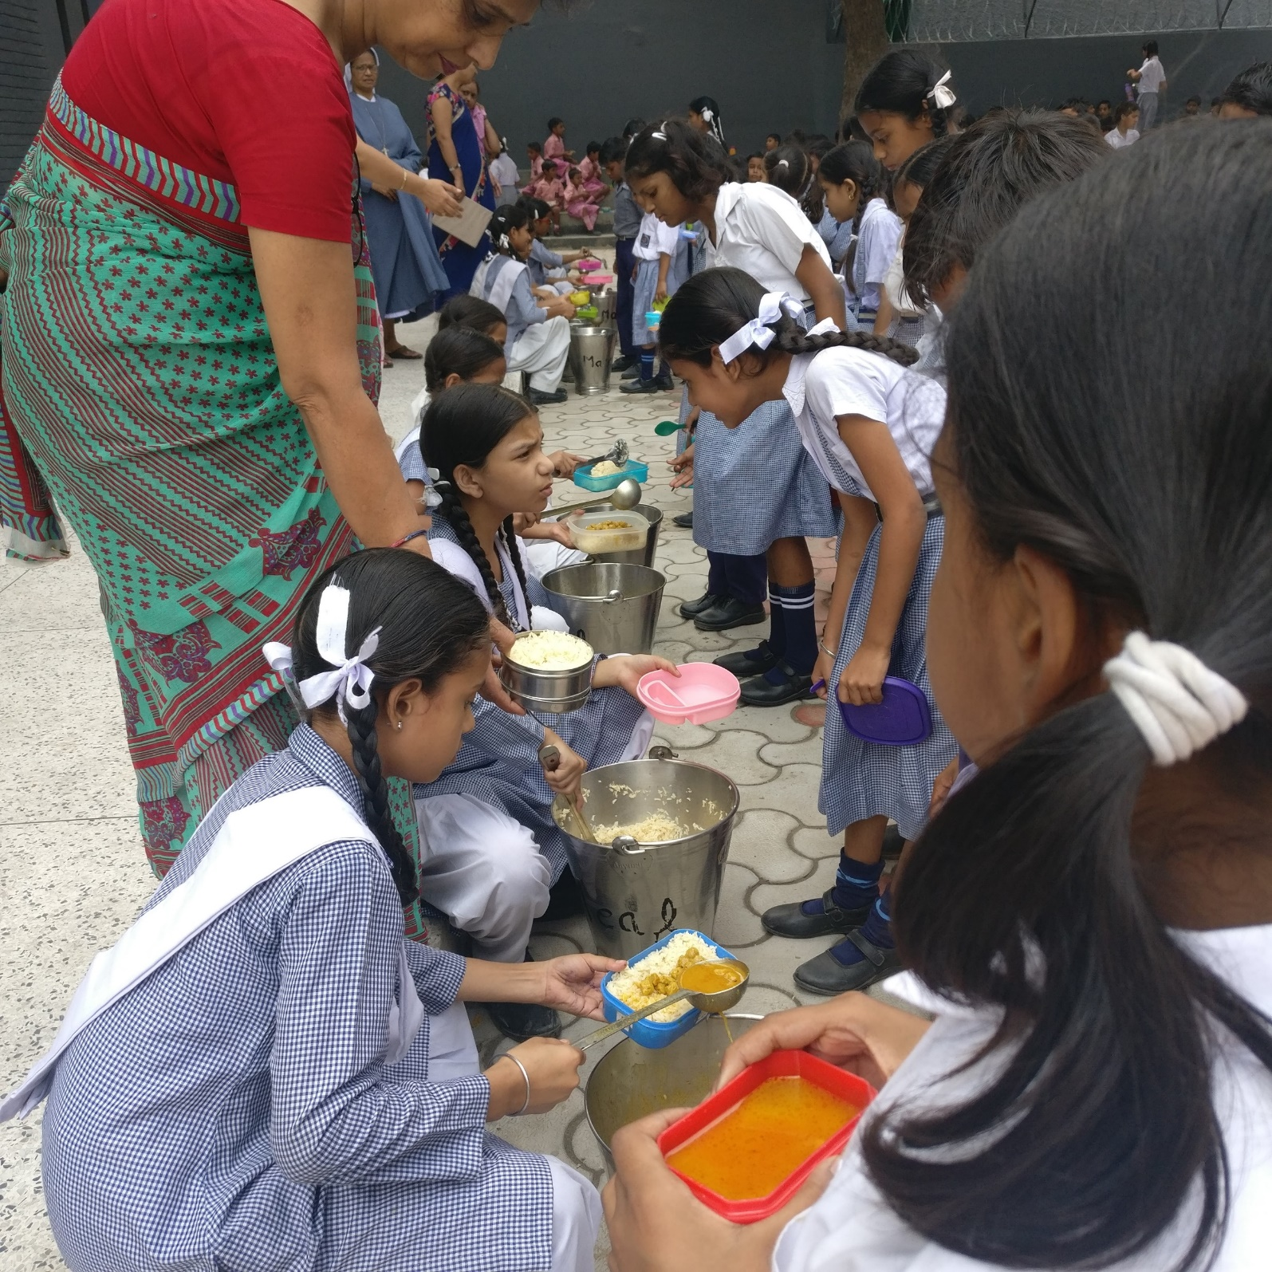

Slide 24


Slide 25
MOTHER’S CARE
Name | : | MOTHER’S CARE INDIA
Registration No. | : | 1234/66
Registered office | : | 16 ORCHARD DR, GIFFNOCK, G46 7NU GLASGOW, SCOTLAND, UK
Tel. No | : | +44-141-6203603
E mail | : | patricialonergan@hotmail.co.uk
Website | : | www.motherscare.org
Year of registration | : | 2009
ENSURING QUALITY EDUCATION UPTO COLLEGE LEVEL

Slide 26
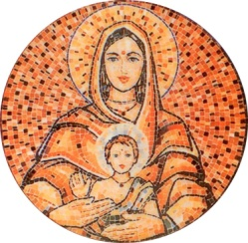
Mother’s Care is a unique programme towards self-reliance by offering financial help for education to those who are less privileged, so that they can stand on their own.
Mother’s Care reaches out to the disadvantaged students by way of individual educational sponsorship to ensure quality education up to college level.

Slide 27
THE GROWTH OF MOTHER’S CARE
IN INDIA – NO. OF CHILDREN - 2009

Slide 28
NO.OF CHILDREN STATE WISE
TOTAL NO.OF CHILDREN – 2009

Slide 29
MOTHER’S CARE PARTNERS AND NO. OF CHILDREN
TOTAL NO OF MC PARTNERS :12
Notes:
NEW

Slide 30
MOTHER’S CARE 2016
GENDER CLASSIFICATION
Total Children - 2009

Slide 31
MOTHER’S CARE 2016
LEVEL OF EDUCATION

Slide 32
MOTHER’S CARE 2016
AGEWISE CLASSIFICATION

Slide 33
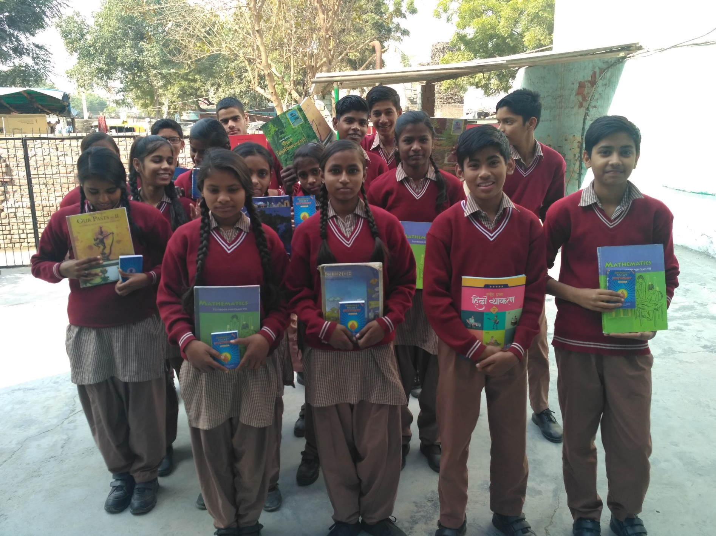

Slide 34
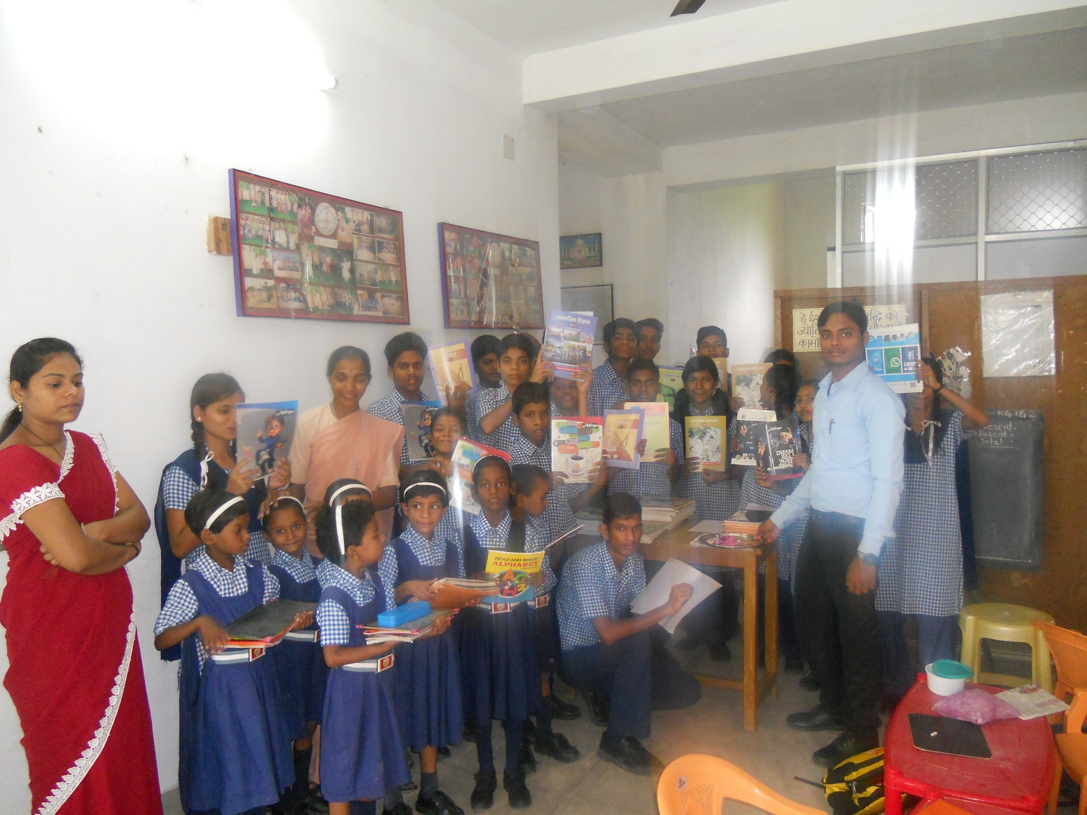

Slide 35
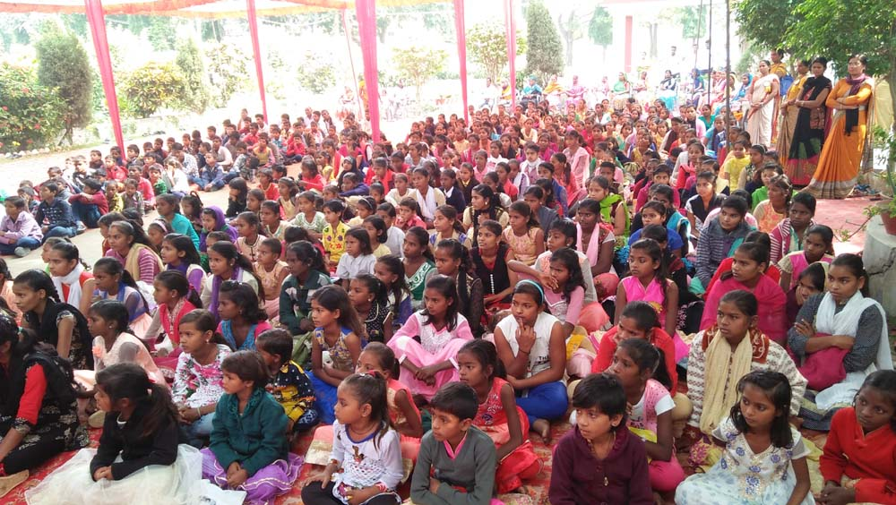

Slide 36
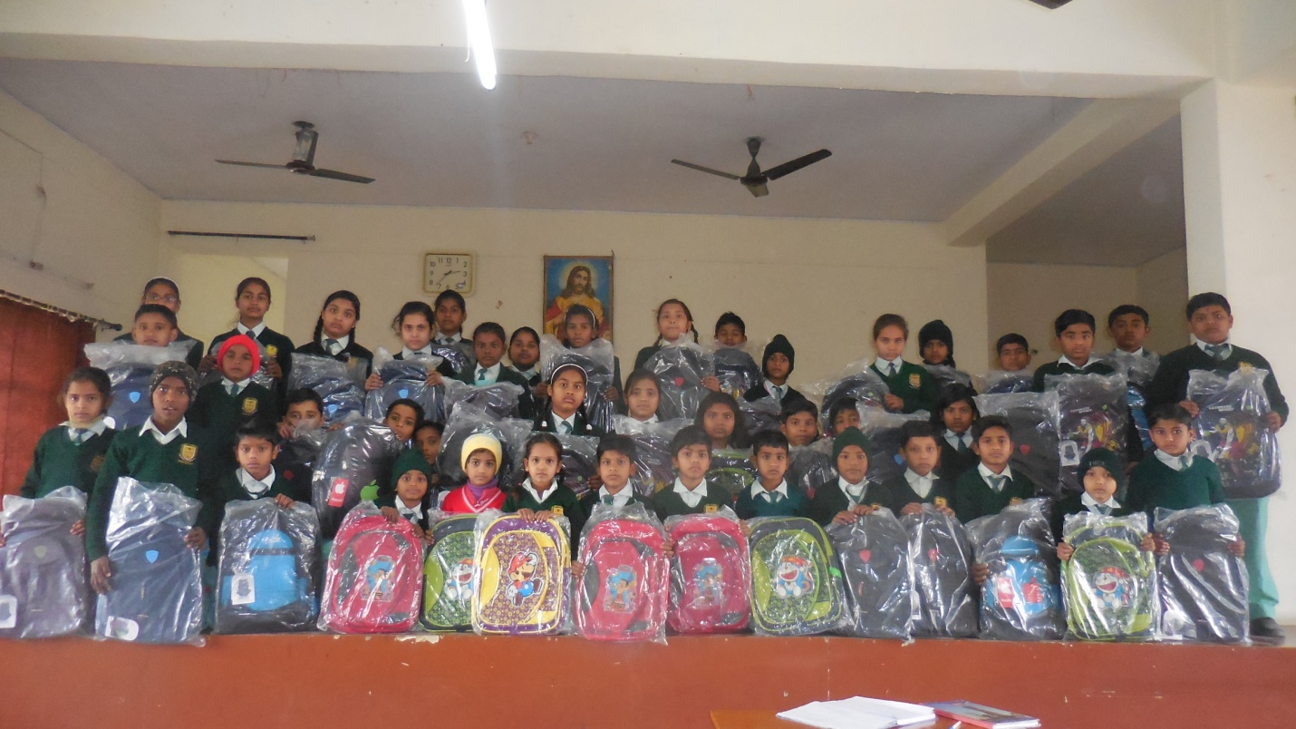

Slide 37
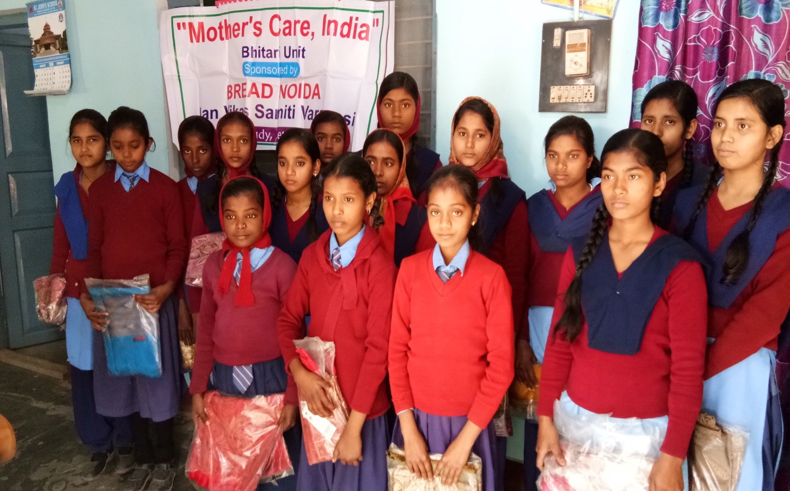

Slide 38
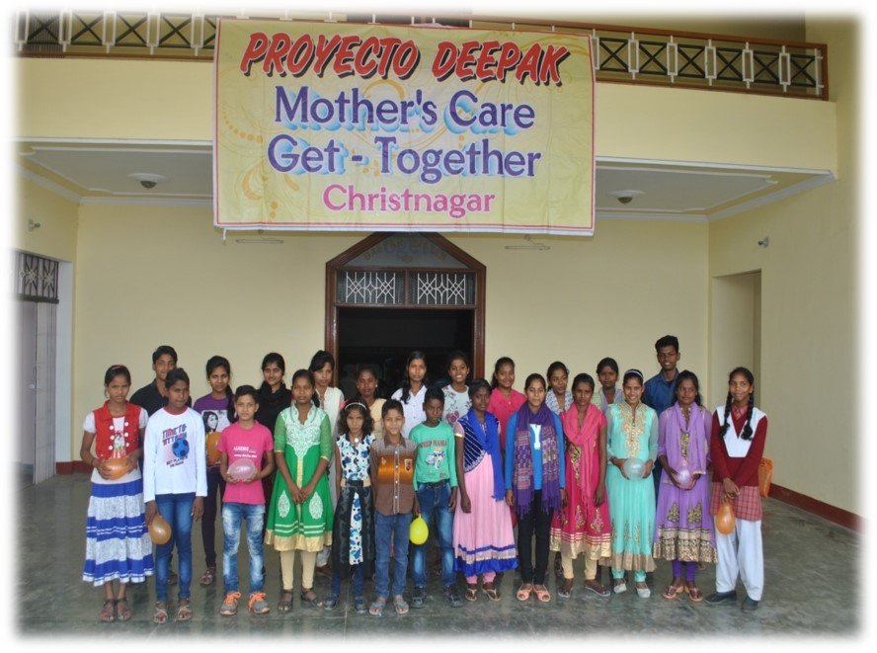

Slide 39
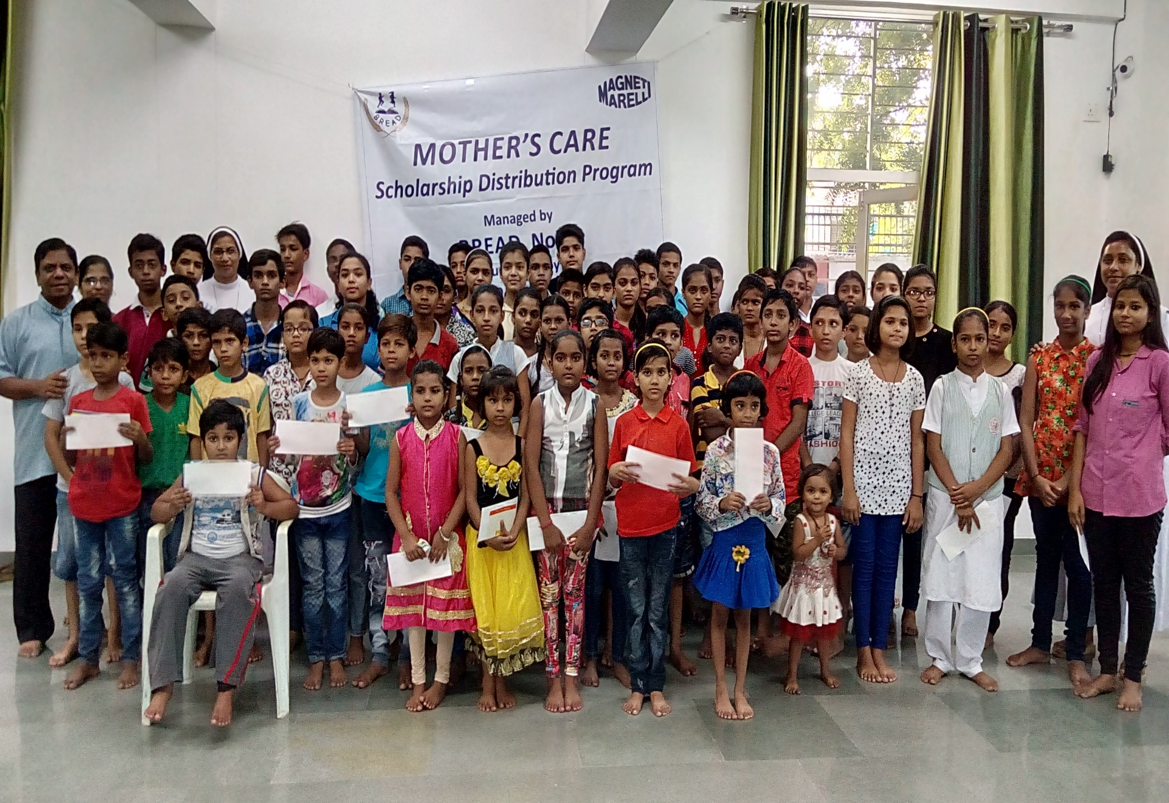

Slide 40
Blossom
Total no. of beneficiaries - 300
At :
St. Theresa’s Welfare center, Vijaya Nagar, Ghaziabad, U P by BREAD - Beneficiaries - 200
Jan Vikas Samiti, VP of IMS, Varanasi, U P - Beneficiaries -100

Slide 41
Mother’s Leap
Total Students Sponsored: 23

Slide 42
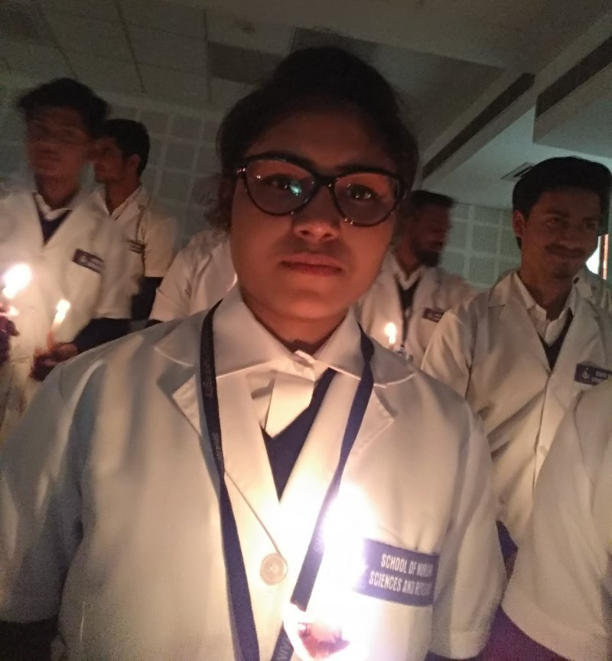
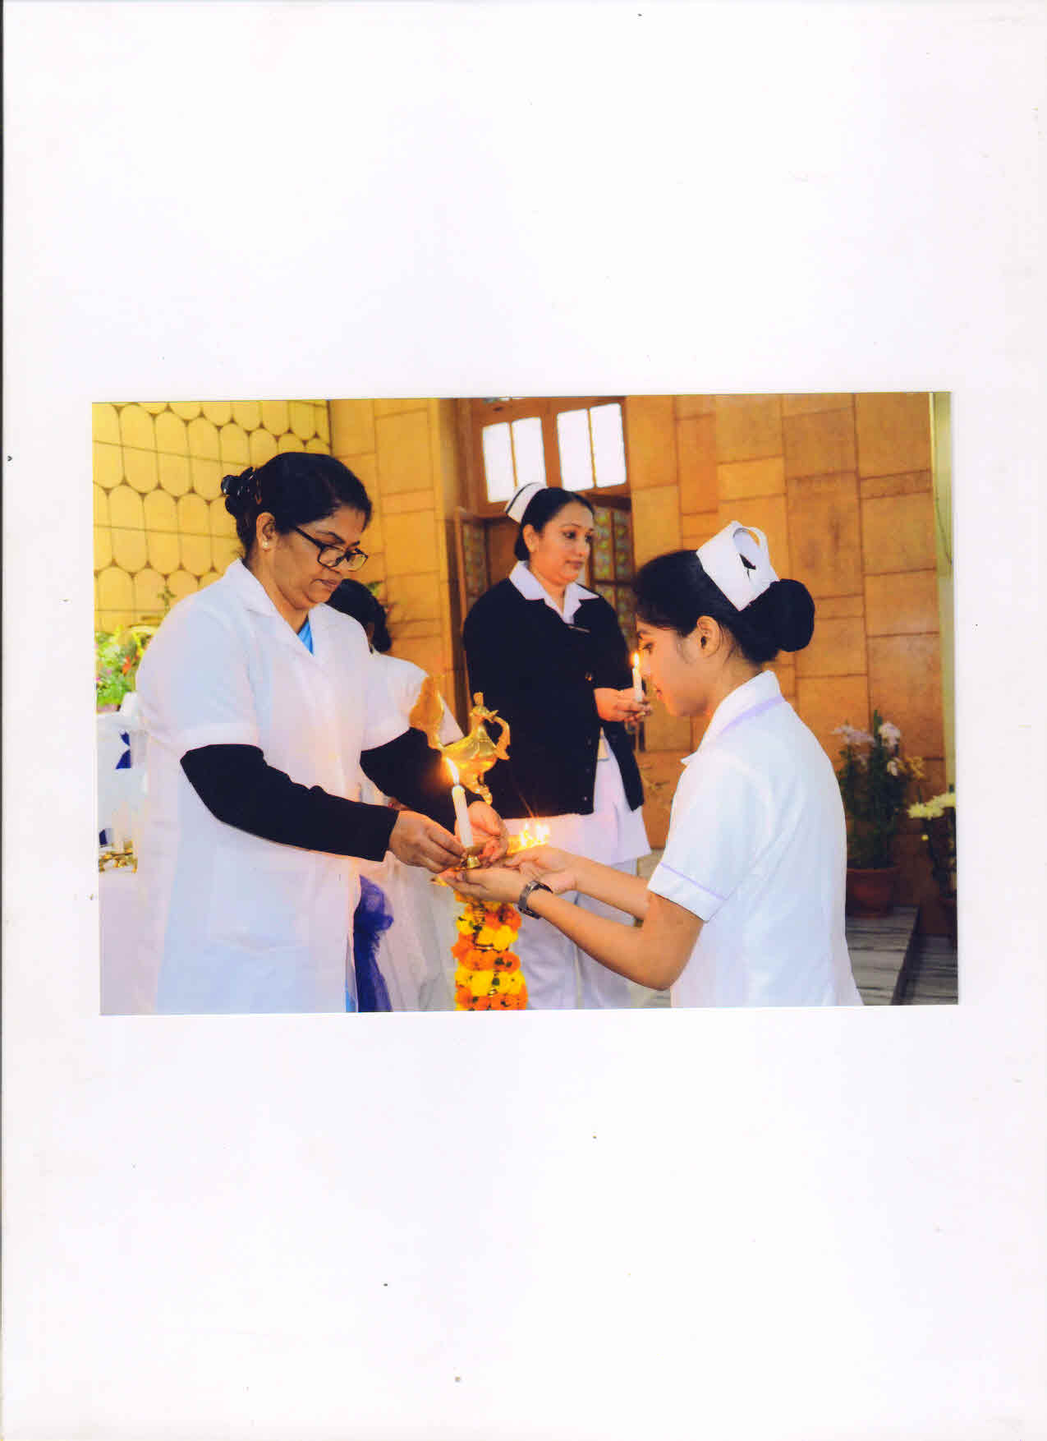
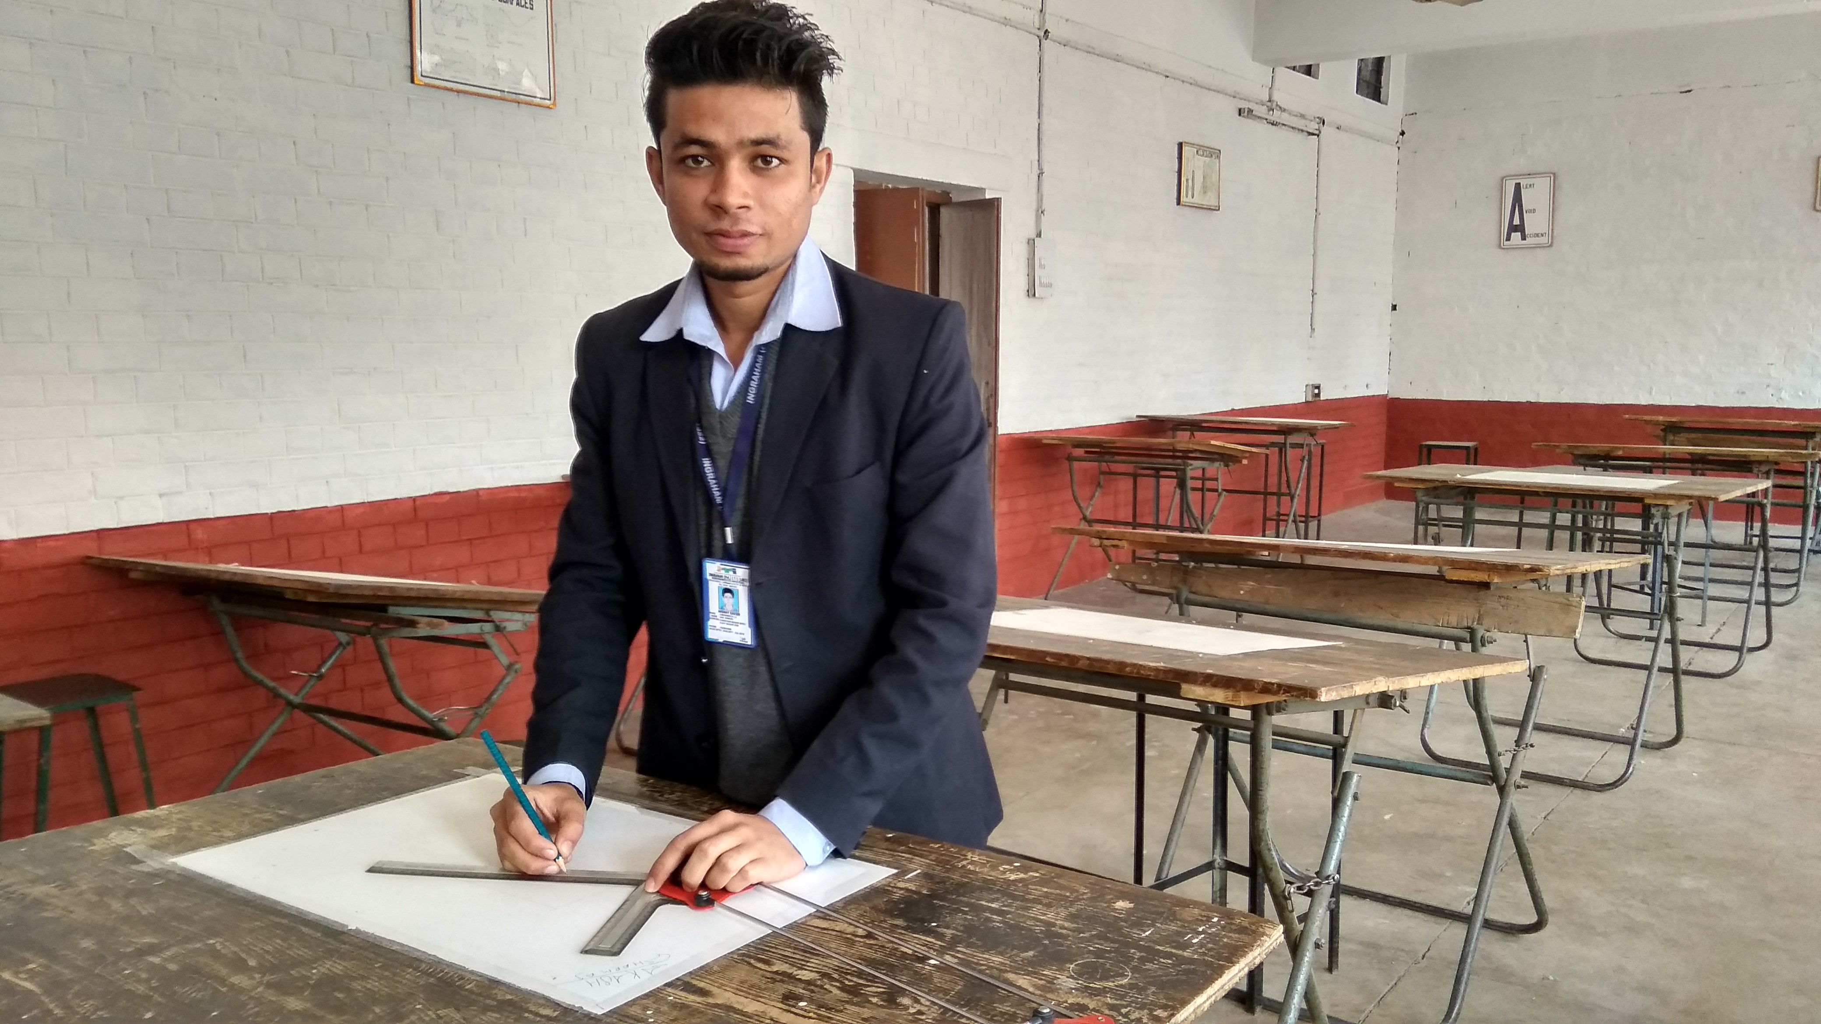
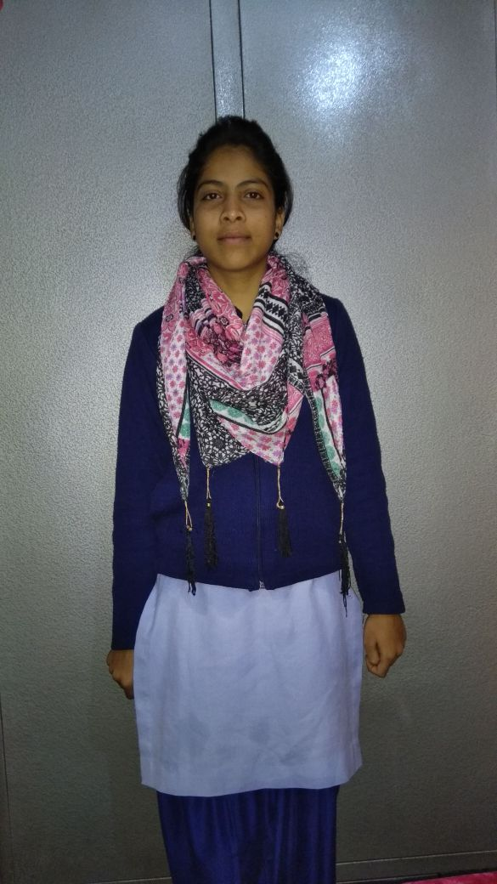
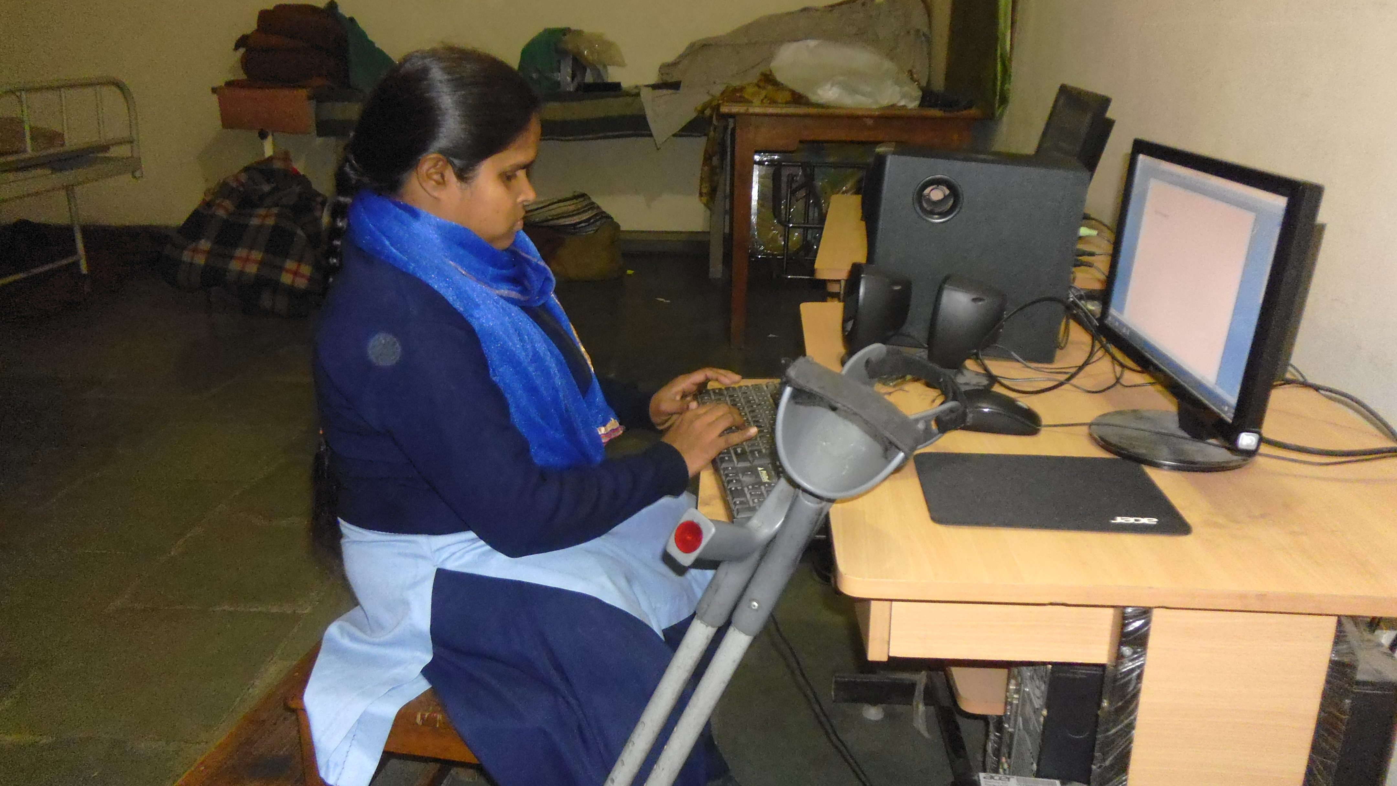
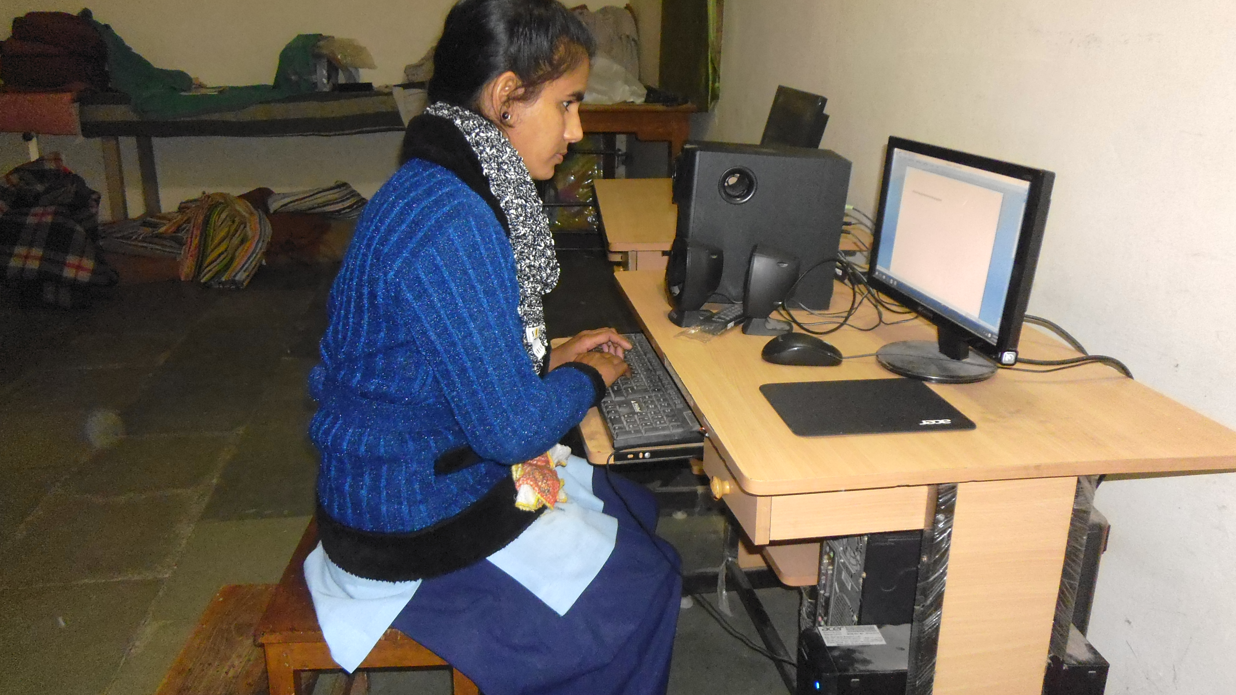
Posing in Uniforms # Being formed

Slide 43
Project Name: Mother’s Leap (Tailoring Center)
CENTER DETAILS
1. | Name of the Center | St. Mary’s Inter College Jhansi
2. | Address | Masiha gunj, sipri Bazar, Jhansi, U P. 284003
3. | Date of Commencement | 1st April 2017
4. | No.of batches | 3
5. | No.of students | 40
6. | No.of teachers | 2
7. | Affiliated to | St. jude vocational trinning center
9. | No. of Tailoring Machines | 15
10. | No.of tailoring Machine sponsored by BREAD | 15

Slide 44
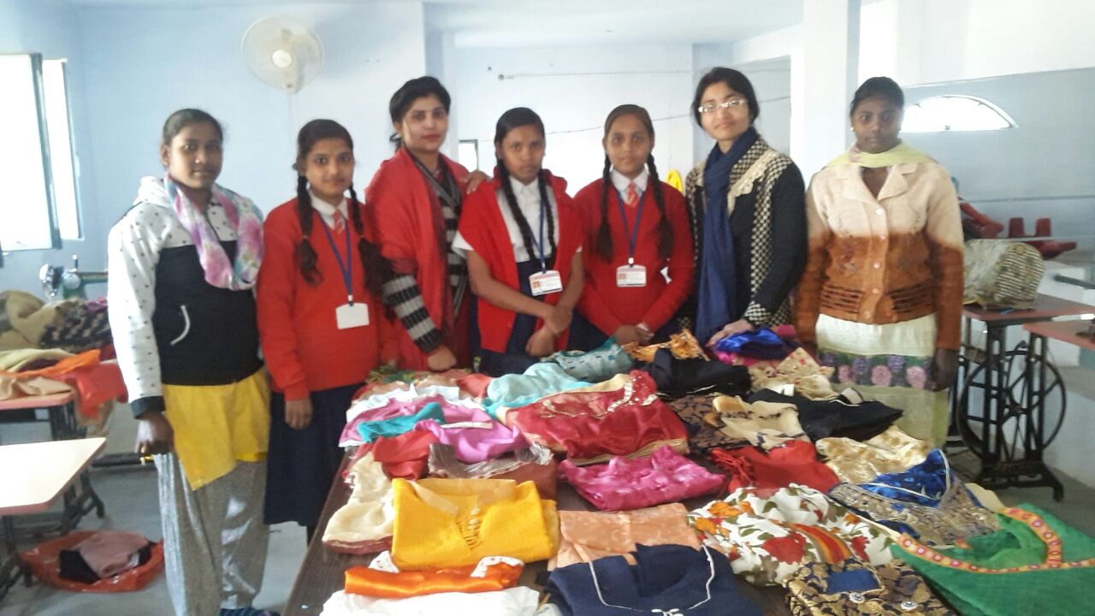

Slide 45
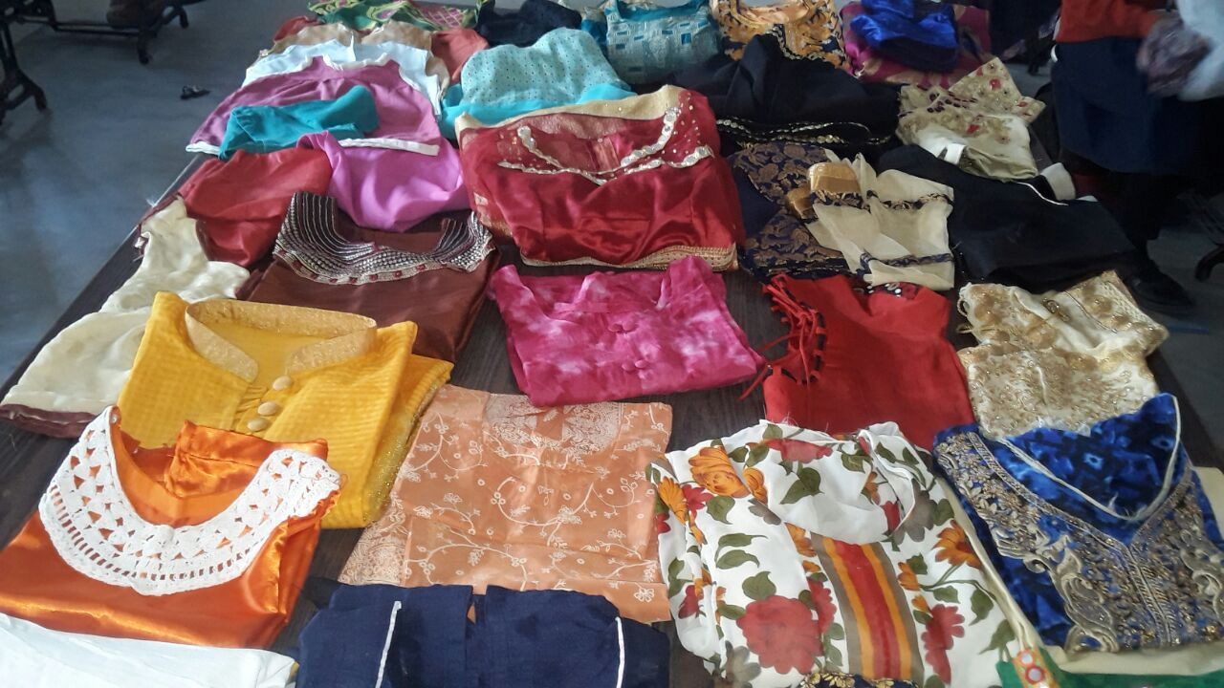

Slide 46
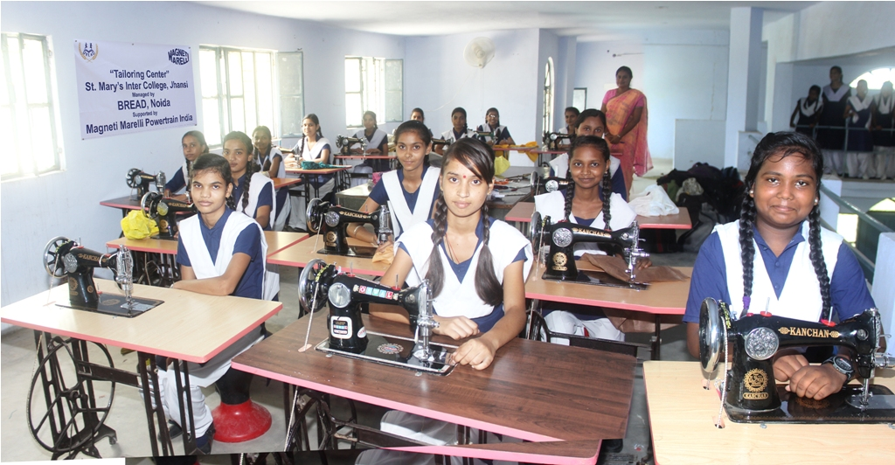

Slide 47
Visit us:
www.breadnoida.org
www.facebook.com/marysmealsindia
www.twitter.com/breadnoida

Slide 48

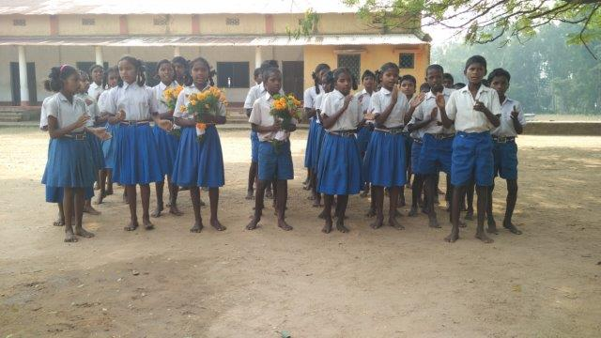
Thank You

