Slide 1
BOARD FOR RESEARCH EDUCATION AND DEVELOPMENT (BREAD) A – 262, Sector – 19, Noida, U P, India - 201301

Slide 2
VISION
Empowerment Through
Education

Slide 3
SHANTY P K
(Member)
MARY CHERIAN
(Treasurer)
CHAIR PERSON FR. PROVINCIAL DP OF IMS
GEORGE OPARATAS (Member)
FRANCIS K.J
(Secretary)
JOSON
THARAKAN JOHN
(Managing Trustee)

Slide 4
Total no. of Beneficiaries – 20954 under
mary’s meals – 19148
Mother’s Care - 1604
Blossom - 200
Mother’s Leap - 2

Slide 5
mary’s meals
Why feeding :
WE BELIEVE
Food & Education is key to development and alleviation of poverty.
2. Food, serves as an incentive to the hungry children to come to the classroom.

Slide 6
mary’s meals feeding - Statewise
Delhi
HR
UP
RJ
BR
MP
WB
JK
HR – Haryana
UP – Uttar Pradesh
BR – Bihar
RJ – Rajasthan
OD – Odisha
MP – Madhya Pradesh
CG – Chattisgrah
JH – Jharkhand
WB – West Bengal
CG
ODI
Calcutta
Mumbai
Chennai
(Madras)

Slide 7
MARY’S MEALS CHILDREN STATEWISE

Slide 8
THE GROWTH OF MARY’S MEALS IN INDIA

Slide 9
BREAD WITH LOCAL PARTNERS AND NO. OF CENTERS
TOTAL CENTERS - 68

Slide 10
BREAD WITH LOCAL PARTNERS AND NO. OF CHILDREN
TOTAL PARTNERS - 19

Slide 11
TYPE OF SCHOOLS/ CENTERS
DATA OF 2015
TOTAL NO OF M.M CENTERS/SCHOOLS :68

Slide 12
GENDER CLASSIFICATION

Slide 13
MM – LEVEL OF EDUCATION

Slide 14
Category of mary’s meals children

Slide 15
Fruits of mary’s meals
Nutritious food for the poor children
Improvement in health status
Children re- discover their childhood
Community participation
Gender discrimination is reduced
Child labour reduced
Improvement in educational conditions
Education among girl children is promoted
Caste imbalance reduced as children eat together

Slide 20
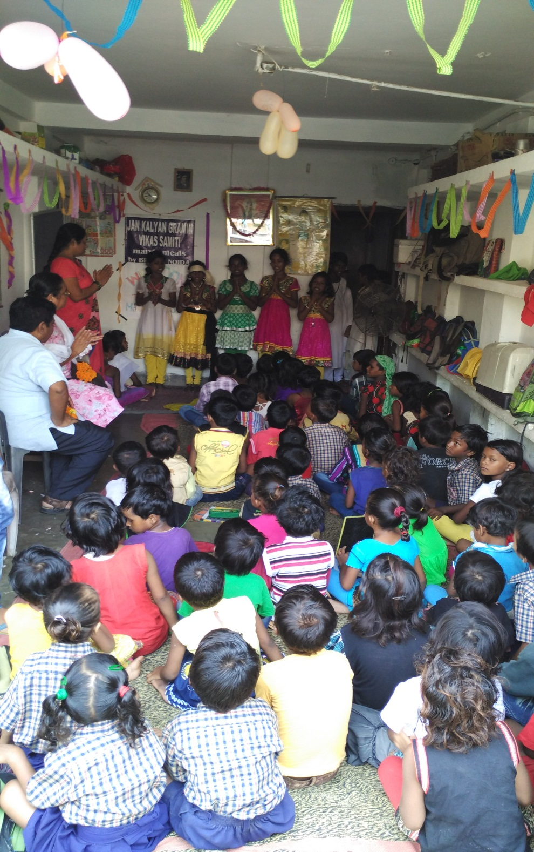

Slide 27
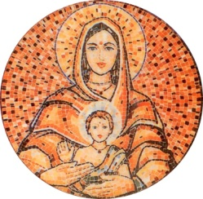
Mother’s Care is a unique programme towards self-reliance by offering financial help for education to those who are less privileged, so that they can stand on their own.
Mother’s Care reaches out to the disadvantaged students by way of individual educational sponsorship to ensure quality education up to college level.

Slide 28
Mother’s Care: Total no. of beneficiaries - 1604 in partnership with:

Slide 29
Mother’s Care - Area of operation
Delhi
HR
UP
RJ
HR- Haryana
DL - Delhi
UP- Uttar Pradesh
BR- Bihar
RJ- Rajasthan
OD - Odisha
KA - Karnataka
KL - Kerala
CG – Chattisgrah
UK - Uttrakhand
WB- West Bengal
BR
WB
CG
ODI
Calcutta
Mumbai
Karnataka
Chennai
(Madras)
Kerala

Slide 30
MOTHER’S CARE PARTNERS AND NO. OF CHILDREN
TOTAL NO OF MC PARTNERS :16
Notes:
NEW

Slide 31
THE GROWTH OF MOTHER’S CARE IN INDIA – NO. OF CHILDREN - 1604

Slide 32
NO.OF CHILDREN STATE WISE TOTAL NO.OF CHILDREN – 1604

Slide 33
MOTHER’S CARE 2015 GENDER CLASSIFICATION Total Children - 1604

Slide 34
MOTHER’S CARE 2015 LEVEL OF EDUCATION

Slide 35
MOTHER’S CARE 2015 AGEWISE CLASSIFICATION

Slide 36
Fruits of Mother’s Care
Increased enrollment
Children study in better schools
Educational accessories provided
Increased awareness about education among the parents
Quality education ensured
A great sense of gratitude of the beneficiaries

Slide 40
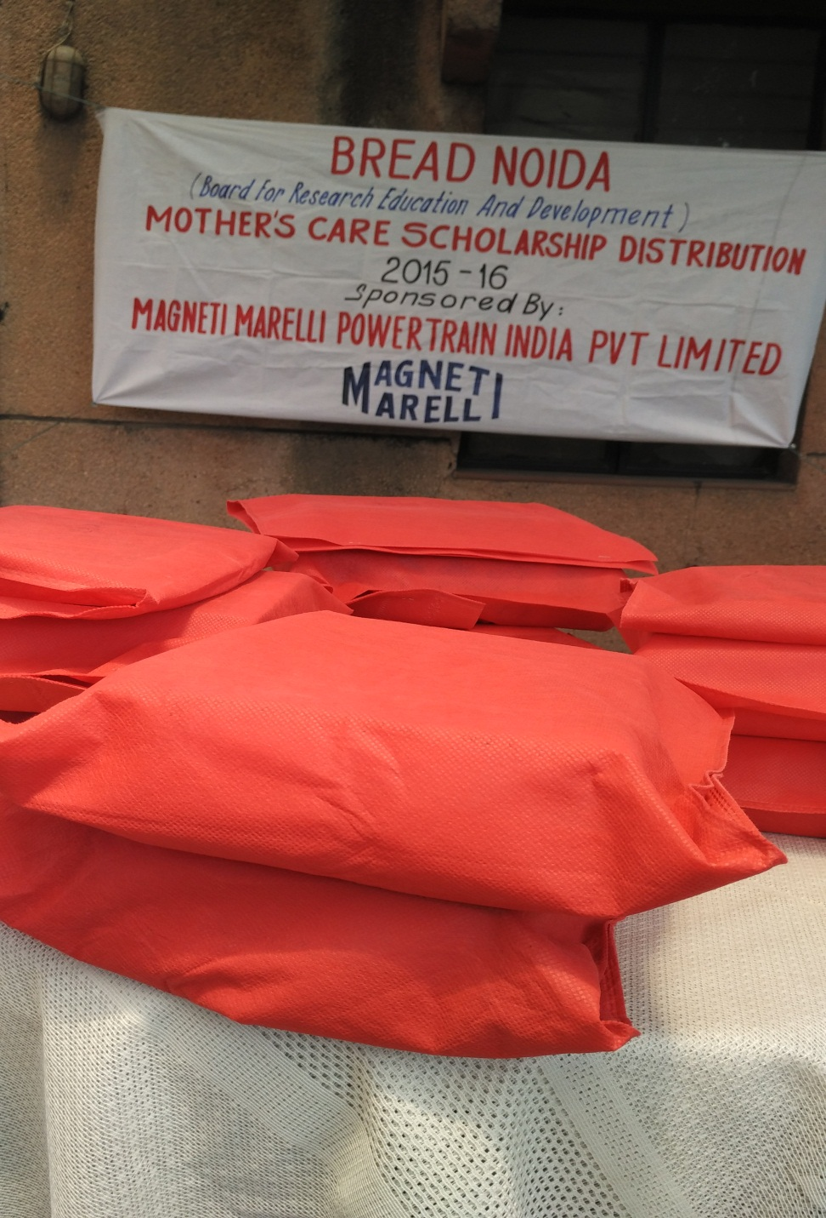

Slide 48
Blossom Total no. of beneficiaries - 200
At :
St. Theresa’s Welfare center, Vijaya Nagar, Ghaziabad, U P by BREAD - Beneficiaries - 100
Jan Vikas Samiti, VP of IMS, Varanasi, U P - Beneficiaries 100

Slide 49
Visit us:
www.breadnoida.org
www.facebook.com/marysmealsindia
www.twitter.com/breadnoida

Slide 50
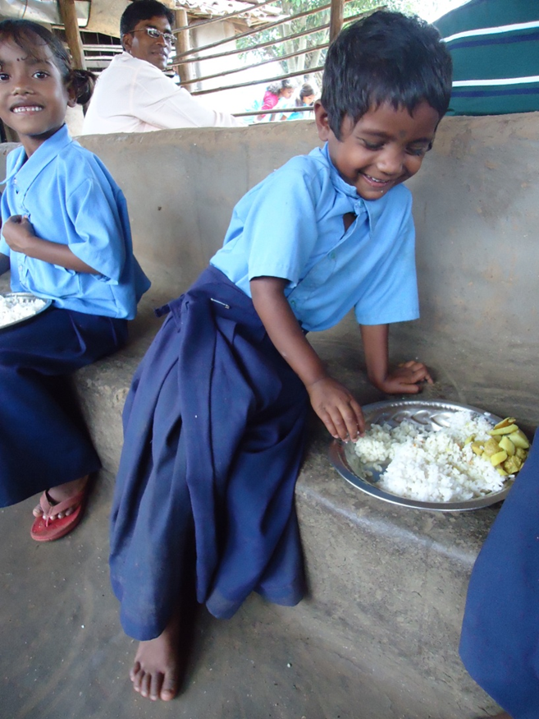
Thank You

