Slide 1
BOARD FOR RESEARCH EDUCATION AND DEVELOPMENT (BREAD) A – 262, Sector – 19, Noida, U P, India - 201301

Slide 2
VISION
Empowerment Through
Education

Slide 3
SHANTY P K
(Member)
MARY CHERIAN
(Treasurer)
CHAIRPERSON FR. PROVINCIAL DP OF IMS
GEORGE OPARATAS (Member)
ROCK TOPPO
(Secretary)
JOSON
THARAKAN JOHN
(Managing Trustee)

Slide 4
Total no. of Beneficiaries – 29216 under
Mary’s Meals: 26639
Mother’s Care - 2515
Mother’s Leap - 62

Slide 5
THE GROWTH OF MARY’S MEALS IN INDIA

Slide 6
Mary’s Meals feeding - Statewise
DL
RJ
UP
BR
MP
WB
JK
UP – Uttar Pradesh
BR – Bihar
RJ – Rajasthan
OD – Odisha
MP – Madhya Pradesh
CG – Chattisgrah
JH – Jharkhand
WB – West Bengal
DL- Delhi
CG
ODI

Slide 7
MARY’S MEALS DISTRIBUTION OF CHILDREN STATEWISE

Slide 8
BREAD WITH LOCAL PARTNERS AND NO. OF CENTERS
TOTAL CENTERS - 67

Slide 9
BREAD WITH LOCAL PARTNERS AND NO. OF CHILDREN
TOTAL PARTNERS – 14
BREAD OFFICE - 3

Slide 10
TYPE OF SCHOOLS/CENTERS
TOTAL NO OF M.M CENTERS/SCHOOLS :67

Slide 11
GENDER CLASSIFICATION

Slide 12
Category of Mary’s Meals children
1271

Slide 13
Level Of Education

Slide 14
Why feeding :
WE BELIEVE 1. Food & Education is key to development and alleviation of poverty. 2. Food, serves as an incentive to the hungry children to come to the classroom

Slide 15
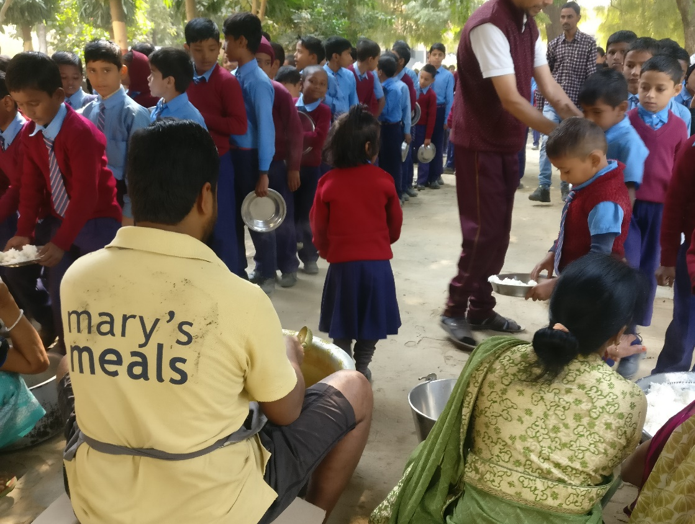
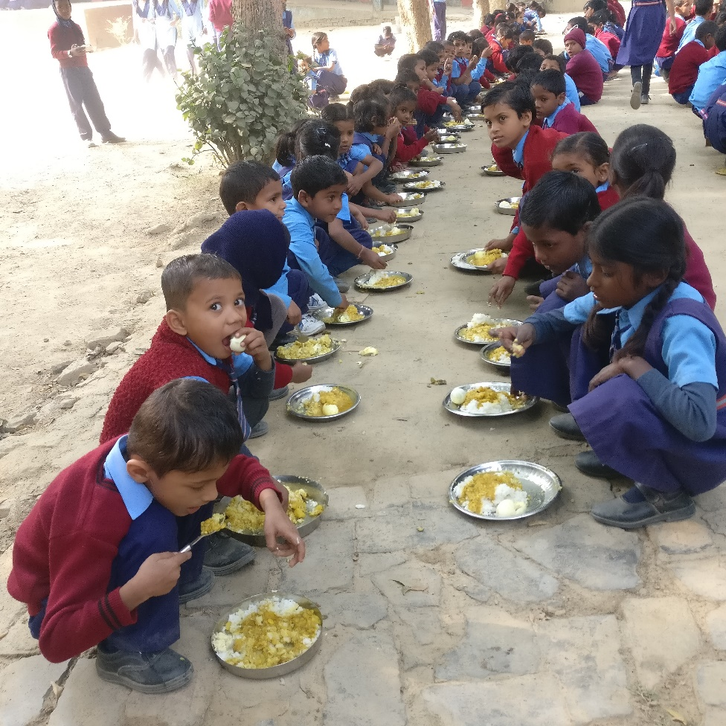
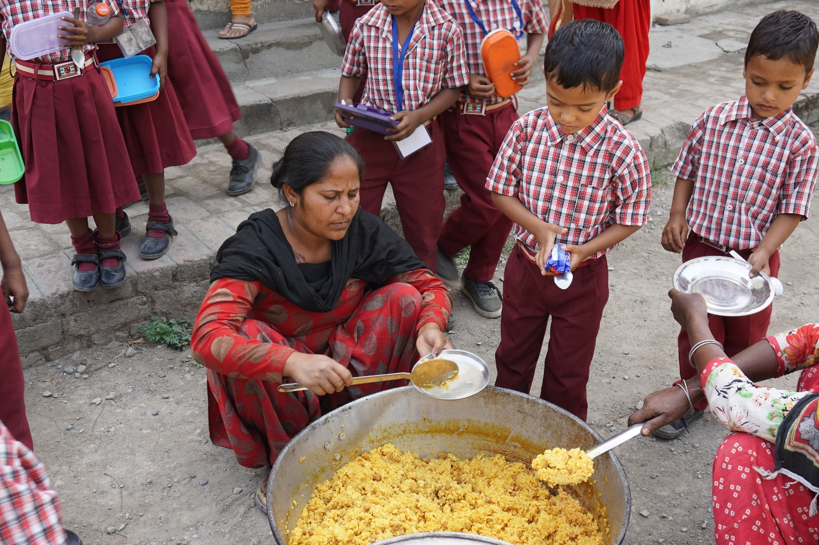

Slide 16
Fruits of mary’s meals
Nutritious food for the poor children
Improvement in health status
Children re- discover their childhood
Community participation
Gender discrimination is reduced
Child labour reduced
Improvement in educational conditions
Education among girl children is promoted
Caste imbalance reduced as children eat together

Slide 17
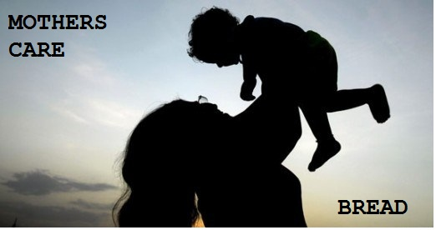

Slide 18
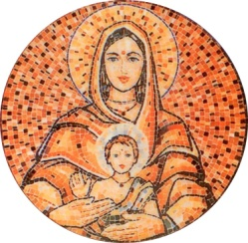
Mother’s Care is a unique programme towards self-reliance by offering financial help for education to those who are less privileged, so that they can stand on their own.
Mother’s Care reaches out to the disadvantaged students by way of individual educational sponsorship to ensure quality education up to college level.

Slide 19
THE GROWTH OF MOTHER’S CARE IN INDIA – NO. OF CHILDREN - 2515

Slide 20
NO.OF CHILDREN STATE WISE TOTAL NO.OF CHILDREN – 2515

Slide 21
MOTHER’S CARE PARTNERS AND NO. OF CHILDREN
TOTAL NO OF MC PARTNERS :15
Notes:
NEW

Slide 22
MOTHER’S CARE GENDER CLASSIFICATION Total Children - 2515

Slide 23
MOTHER’S CARE LEVEL OF EDUCATION

Slide 24
MOTHER’S CARE AGEWISE CLASSIFICATION

Slide 25
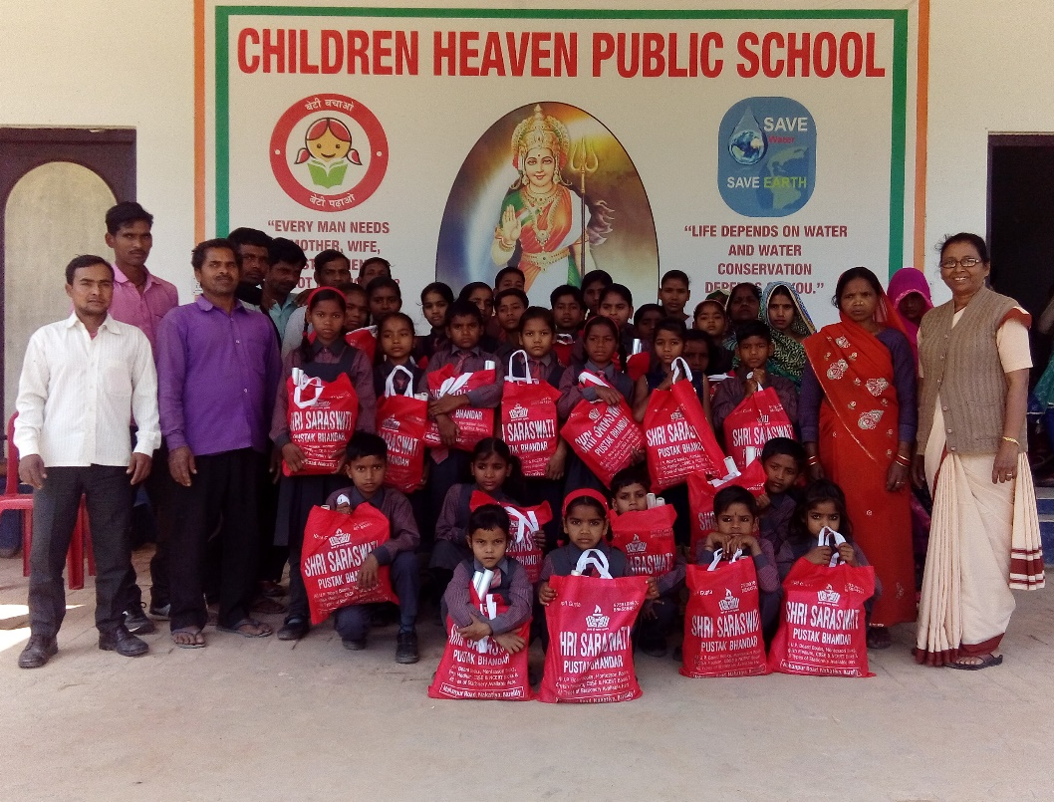
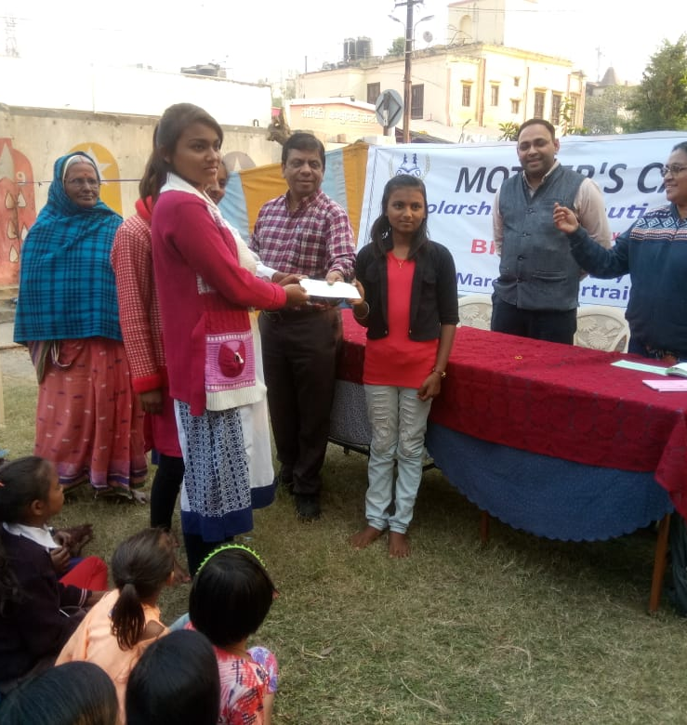
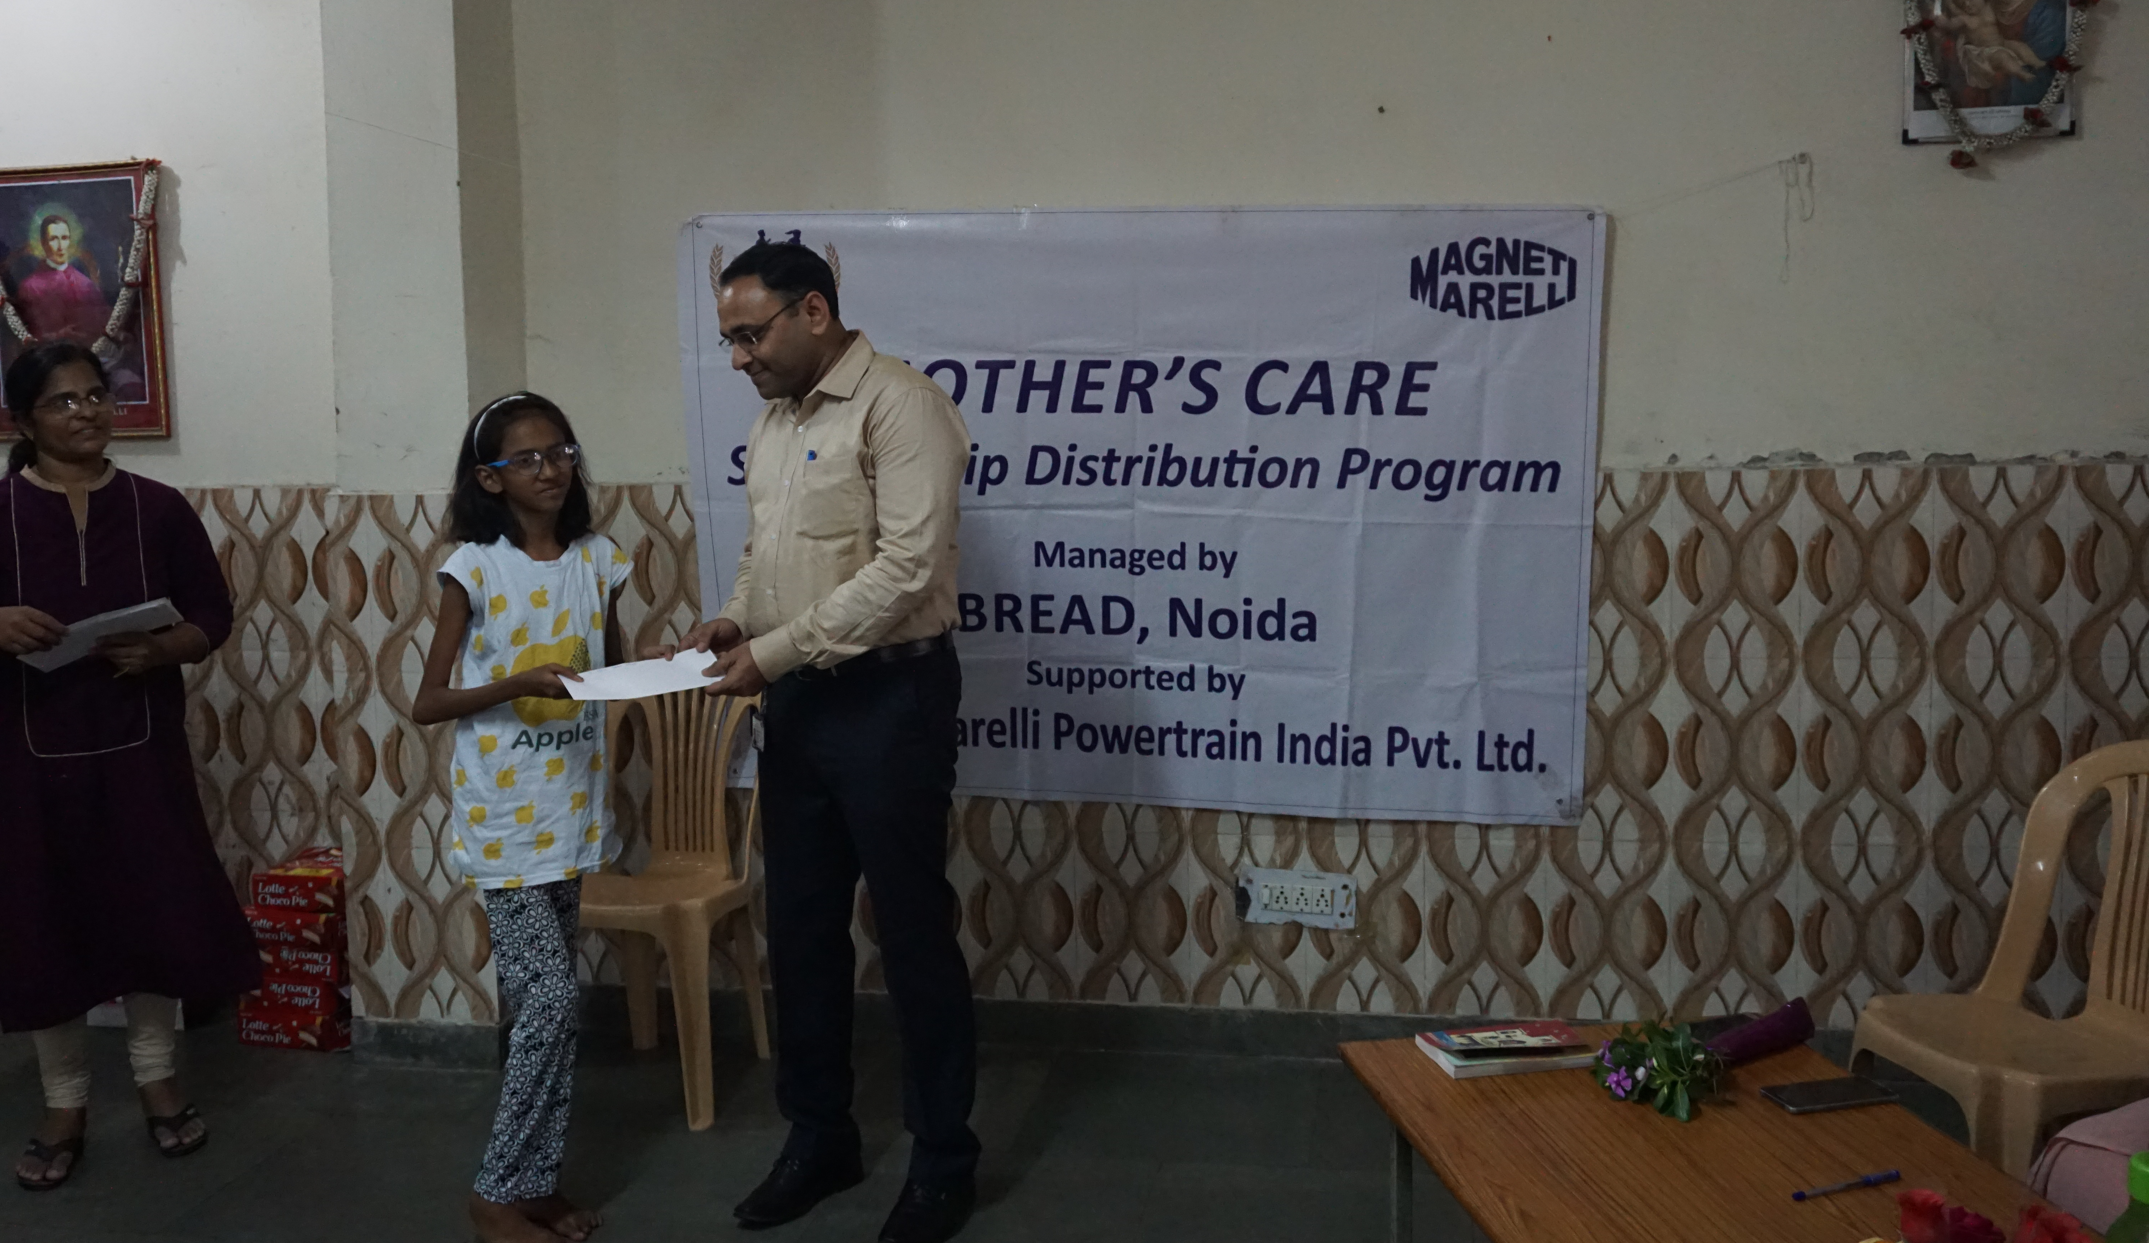
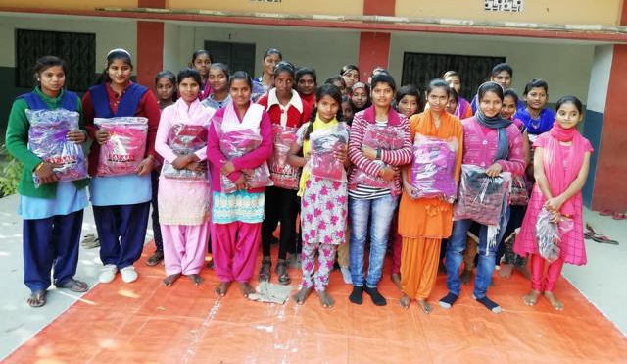
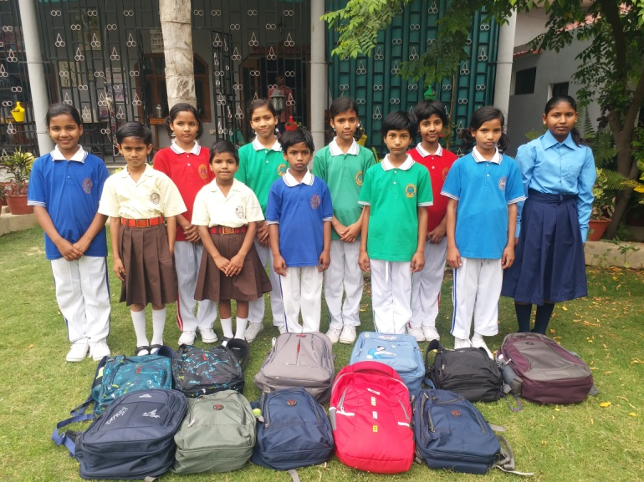

Slide 26
MOTHER’S LEAP
OBJECTIVES
Offering monetary assistance for the vocational training to the identified underprivileged children, to help fulfil their potentials and become self-reliant.
RESULT
Improvement of their livelihood through enhancement of their opportunities of employment and self-employment.

Slide 27
Mother’s Leap Total Students Sponsored: 62
State wise distribution of beneficiaries

Slide 29
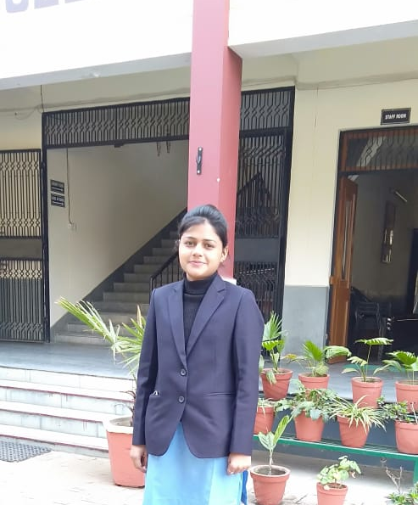
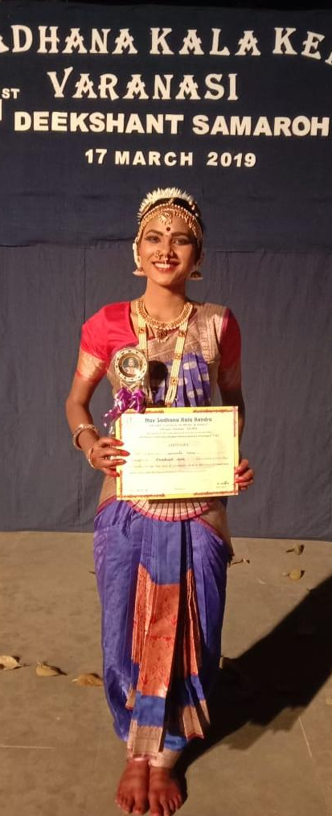
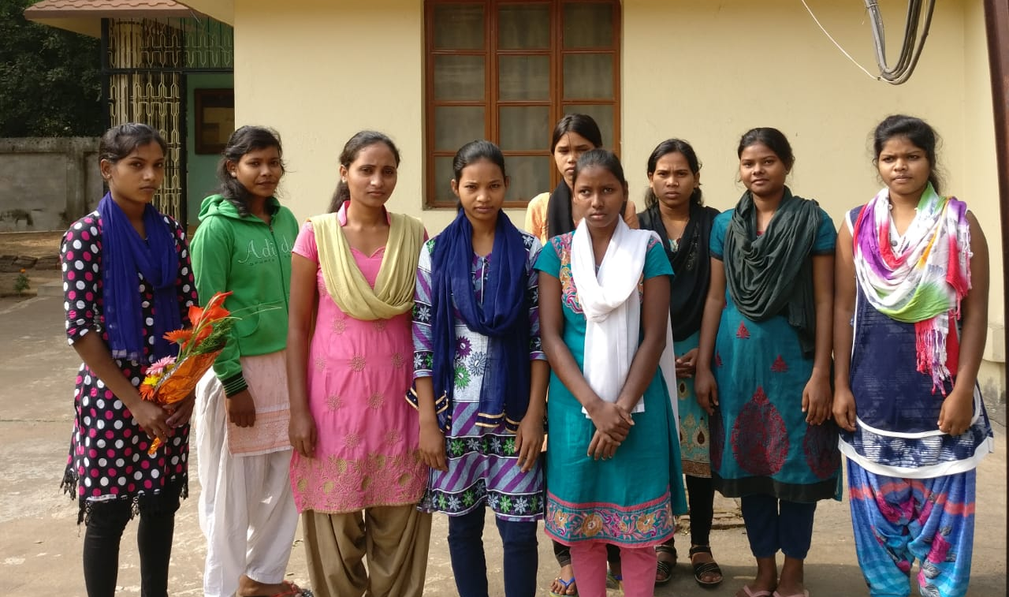
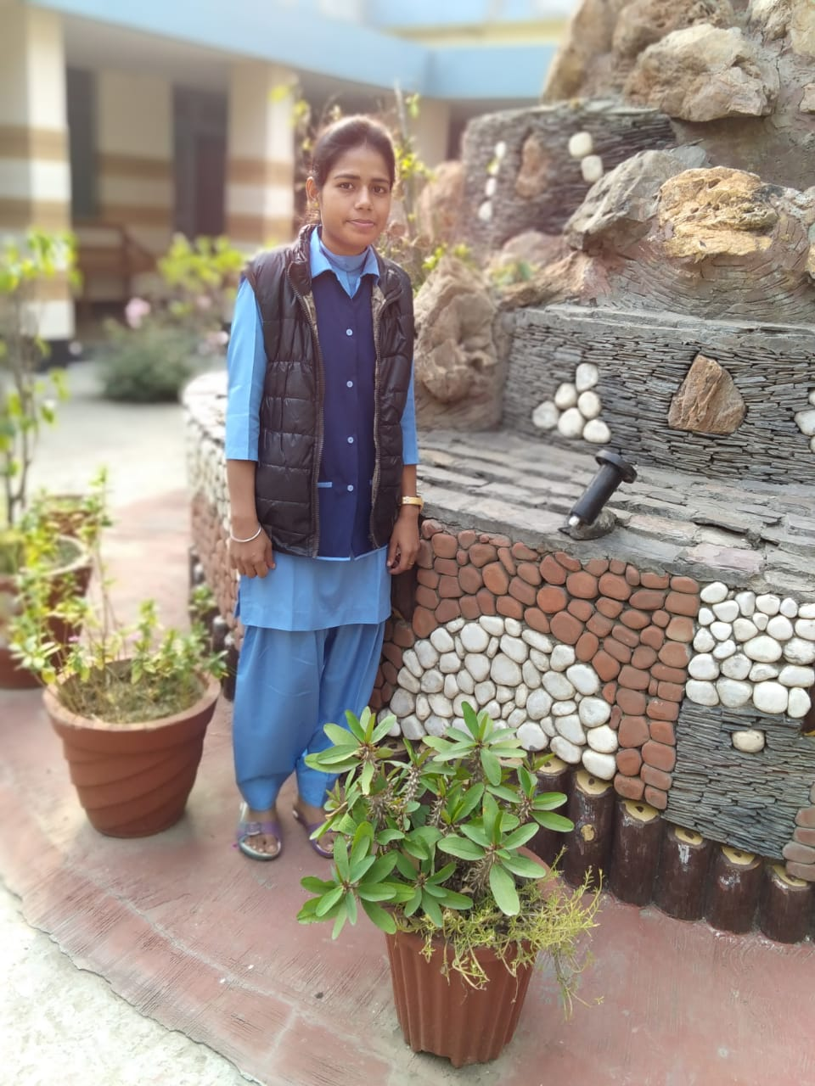
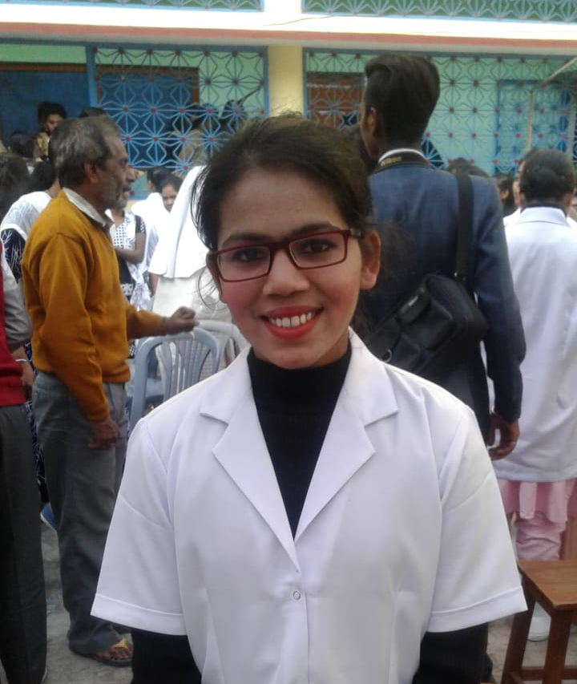
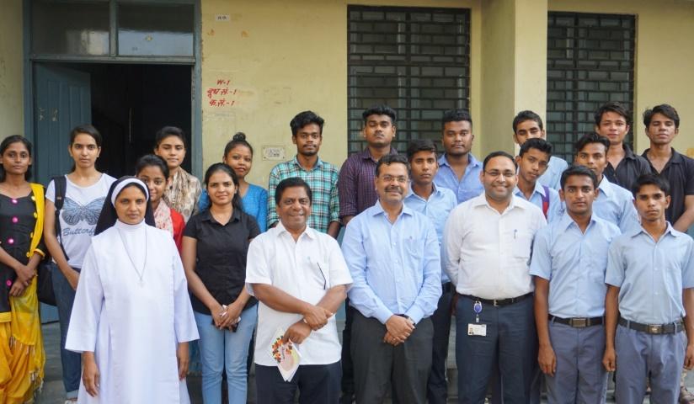

Slide 30
SCHOOL IMPROVEMENT PROGRAM
Project Objective : To ensure that students are provided with the scope of holistic development and the school is equipped with the necessary infrastructure.
Project Result It is ensured that every child receives all the required facilities in the school necessary for the smooth functioning of the school and quality education.
SCHOOLS | DEVELOPMENT MADE
CDM High School, Kuwakheda | Renovation of toilets, prepared play ground and children’s park.
Mahatma Gandhi Adarsh Vidyalaya, Varanasi | Interlocked the assembly ground and roofing of the stage
St. Mary’s Junior High School, Baijapur | Built a computer lab
St. Jude’s Shanti Sadan Sec. School, Tambesra | Prepared the ground. Ride and swings were fixed for the children

Slide 31
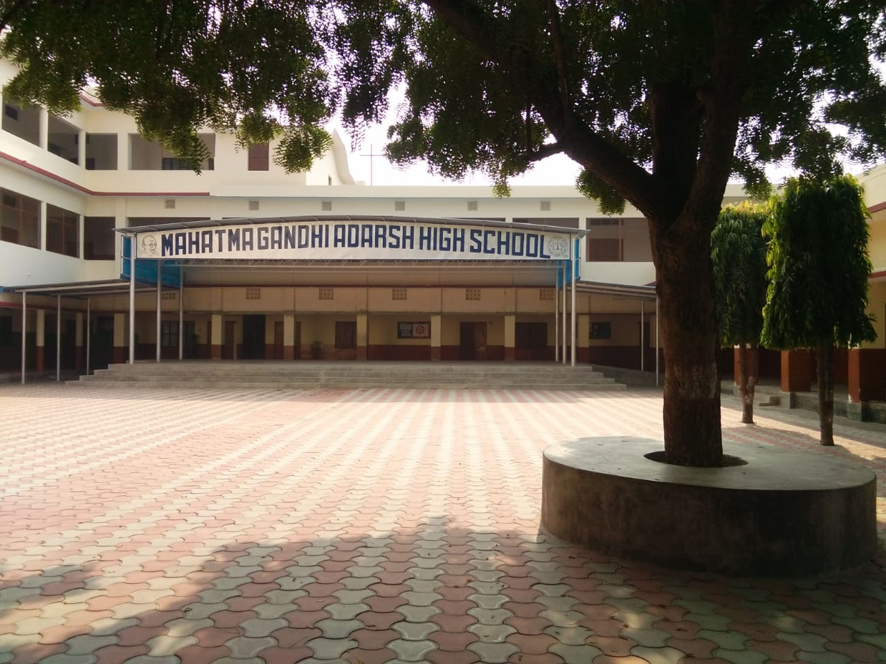
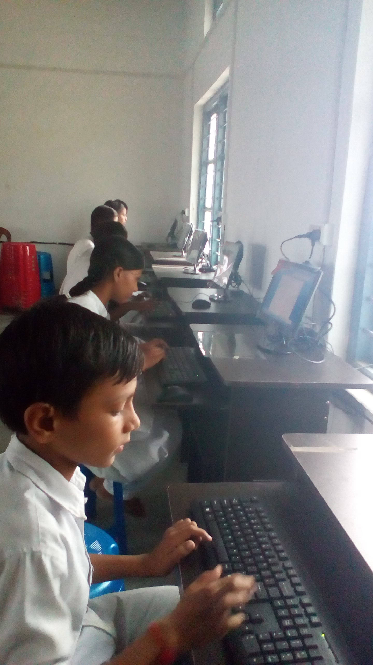
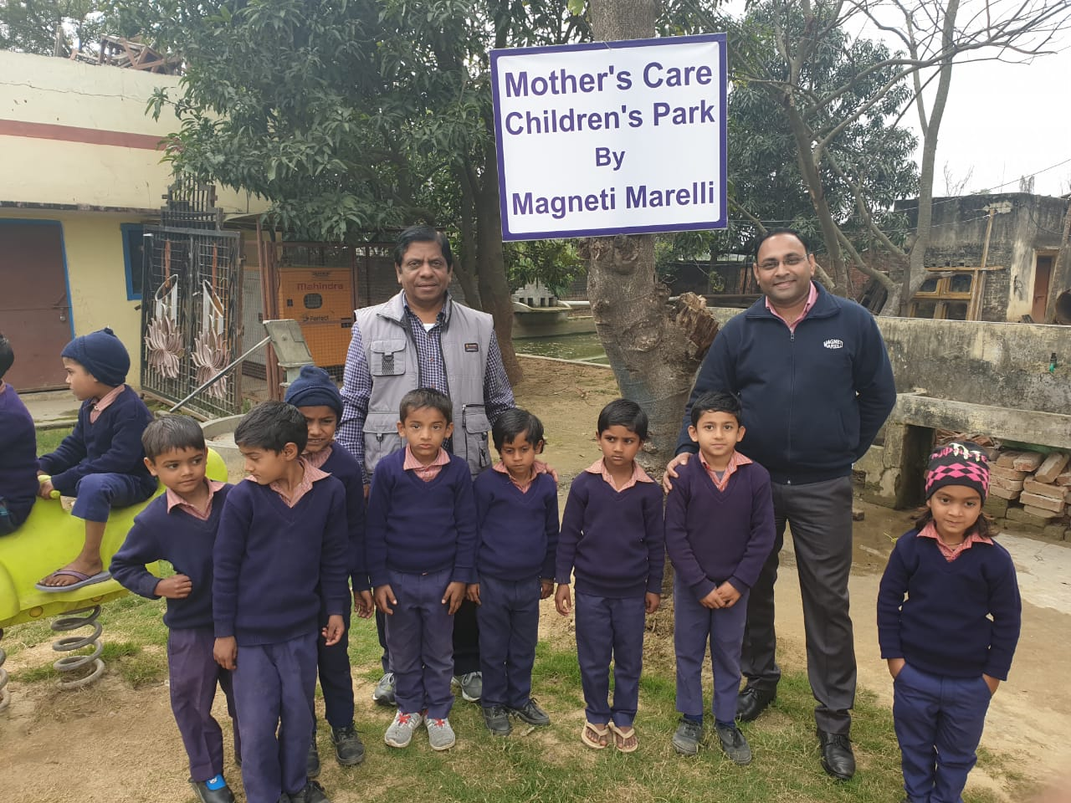
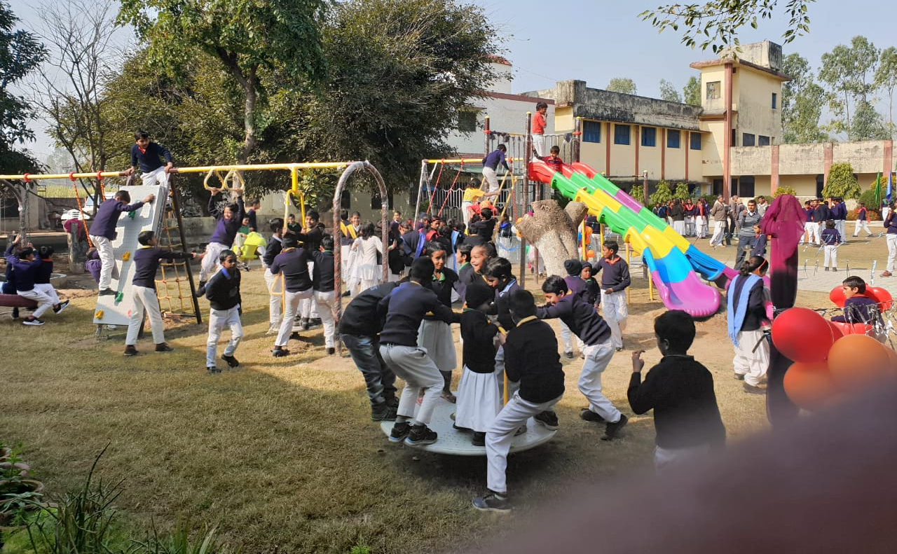
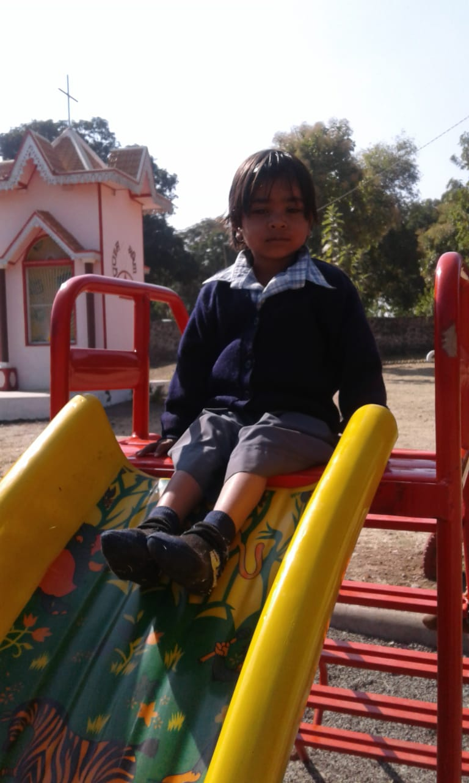
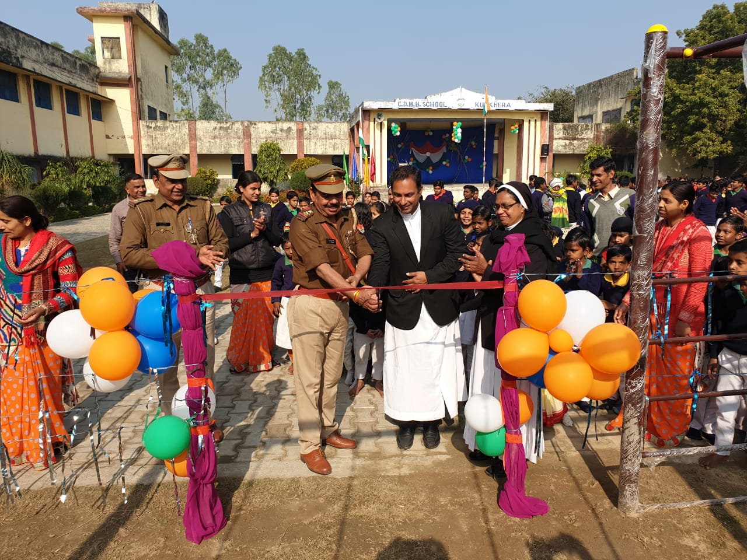

Slide 32
LIFE SKILL EDUCATION
Project Objective :- To empower young people to take positive action to protect themselves and promote health and positive social relationships.
Project Result :- Life skill session has helped children to get a break from their daily routine and get aware about ones own responsibility towards ones life.
Process:- The schools (only for economically weaker section) contact BREAD or BREAD identifies similar schools. The schools are supposed to inform of the target group and the issue to be dealt. The BREAD staff in-charge of life skills arranges for the class. The topic of focus is broken into simpler forms and children are helped to learn by doing. Various activities, songs, videos and games are employed to make the whole session interesting and more understanding.

Slide 33
Life Skill Education - Themes
SL NO | DATE | SCHOOL | CLASS | THEME
1 | 26/11/18 | Holy Child School, Ghaziabad | 10 | Preparation for exams
2 | 27/11/18 | Holy Child School, Ghaziabad | 9 | Preparation for exams
3 | 18/12/18 | Holy Child School, Ghaziabad | 8 | Preparation for exams
4 | 18/12/18 | Holy Child School, Ghaziabad | 4 | Body Safety and sexual safety
5 | 19/12/18 | Holy Child School, Ghaziabad | 3 | Body Safety and sexual safety
6 | 19/02/19 | St.Teressa’s Welfare Centre | 2 | Hygiene
7 | 20/02/19 | St.Teressa’s Welfare Centre | 3 | Good language
8 | 21/02/19 | St.Teressa’s Welfare Centre | 4 & 6 | Motivation to work hard
9 | 22/02/19 | St.Teressa’s Welfare Centre | 5 | Motivation to work hard
10 | 12/03/2019 | St.Teressa’s Welfare Centre | Adolescents | Body safety and protection

Slide 34
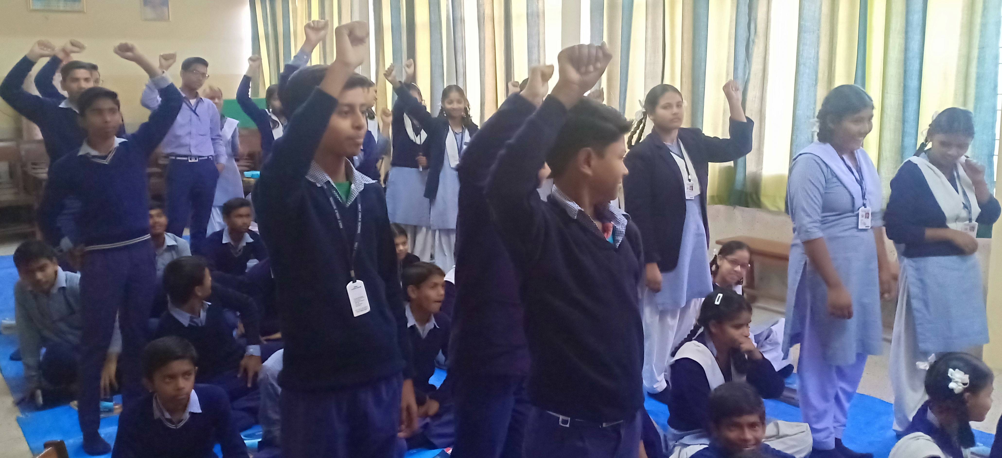
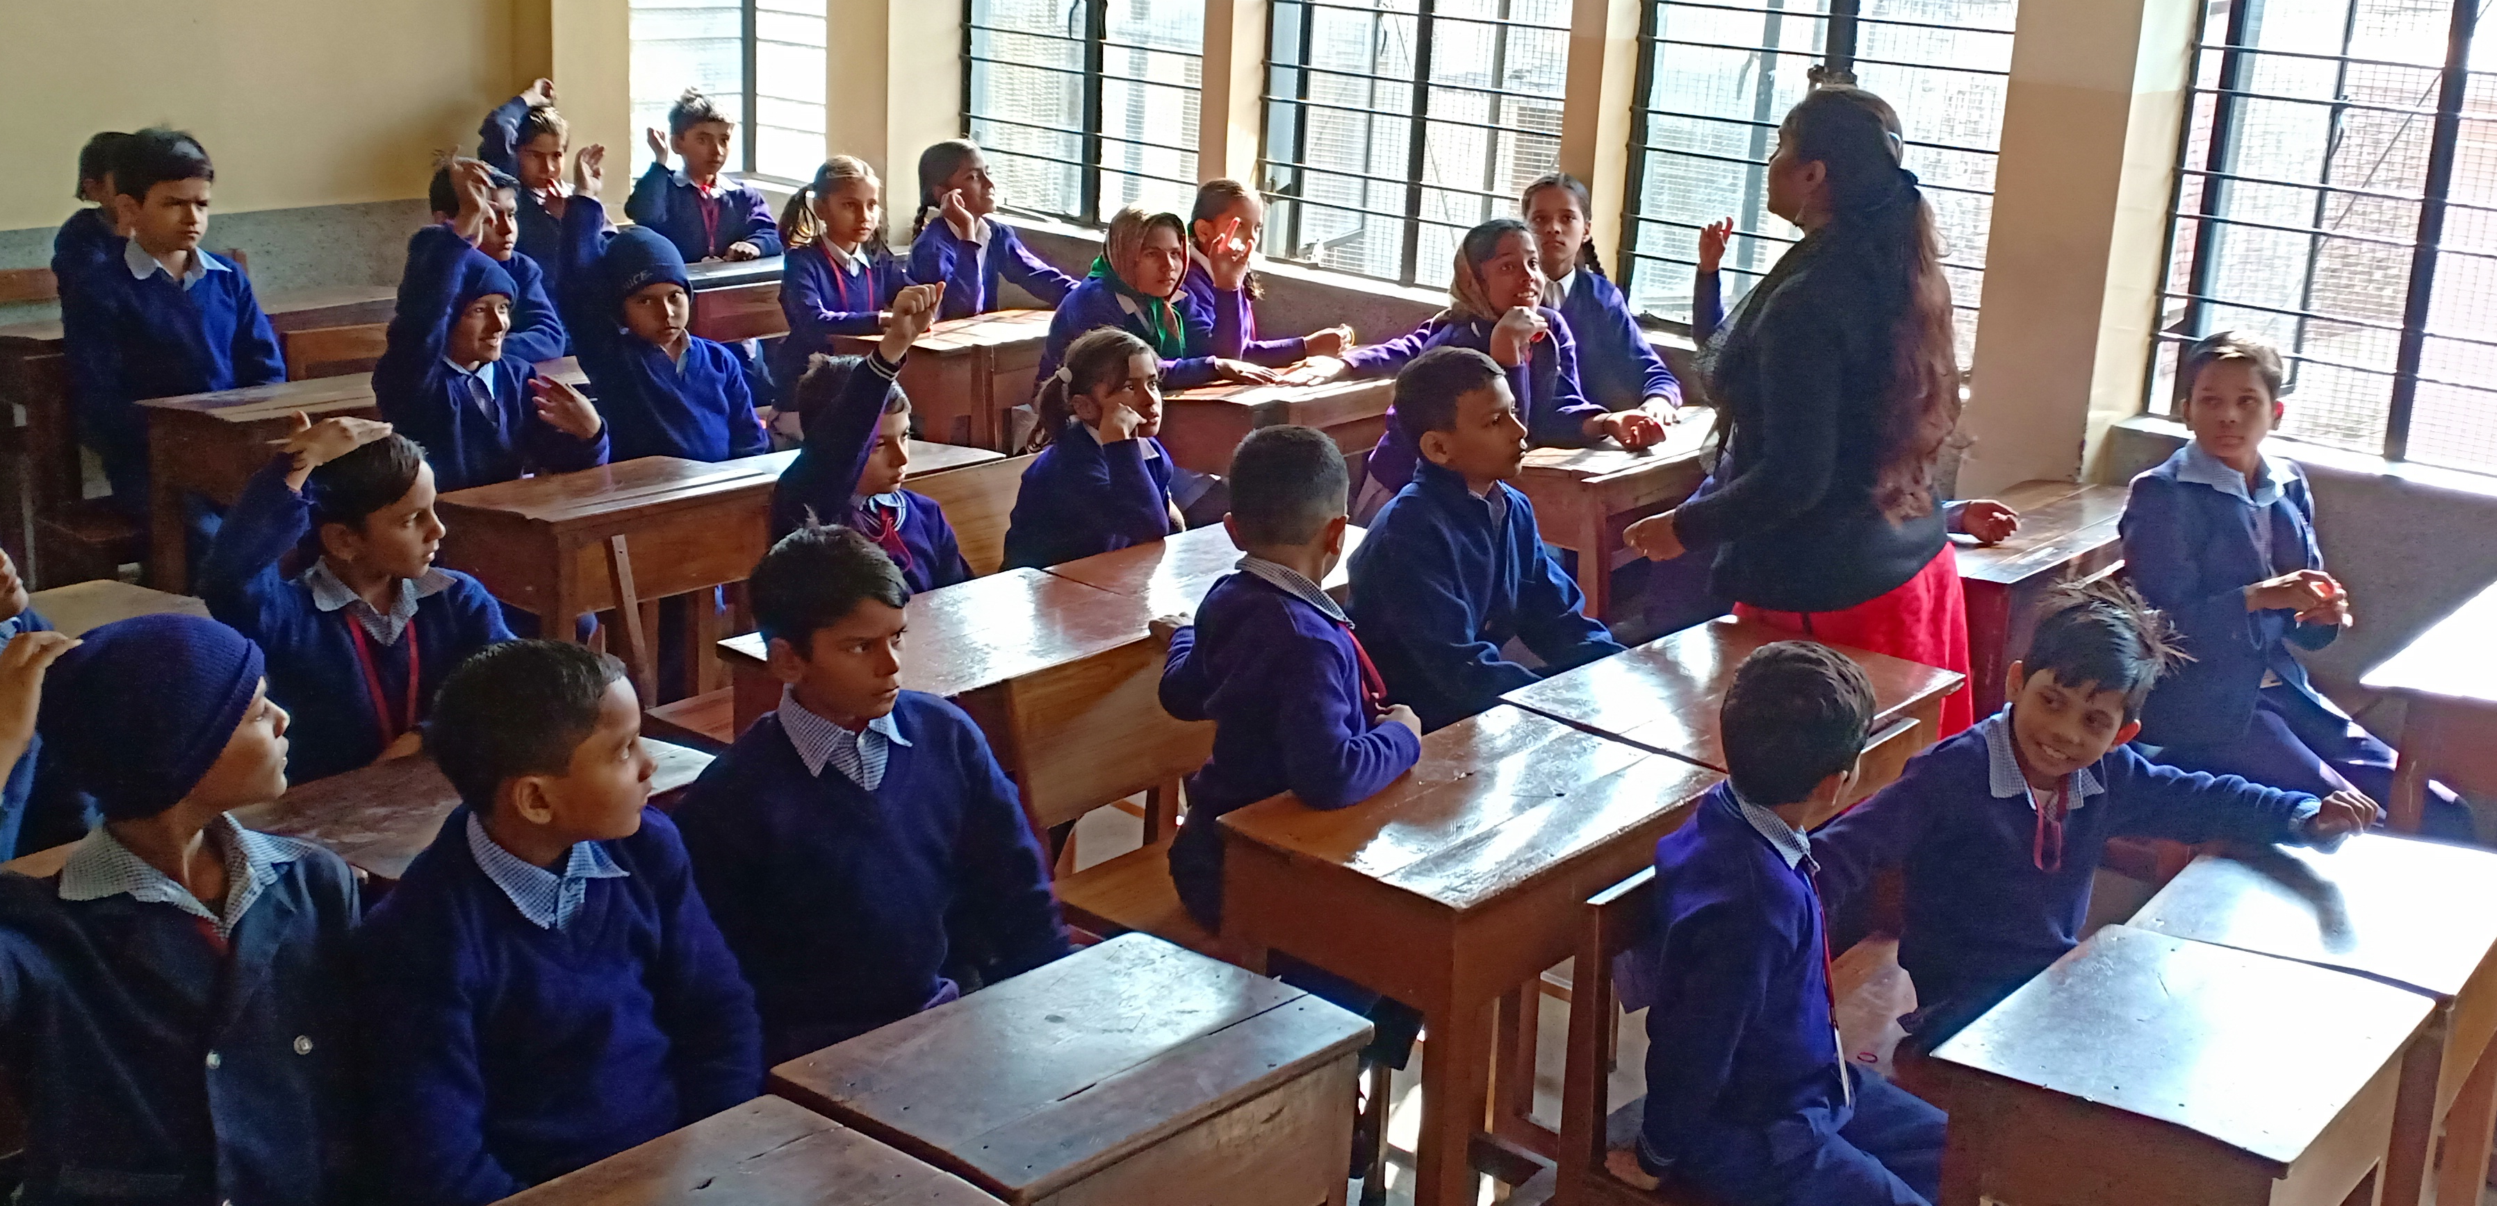
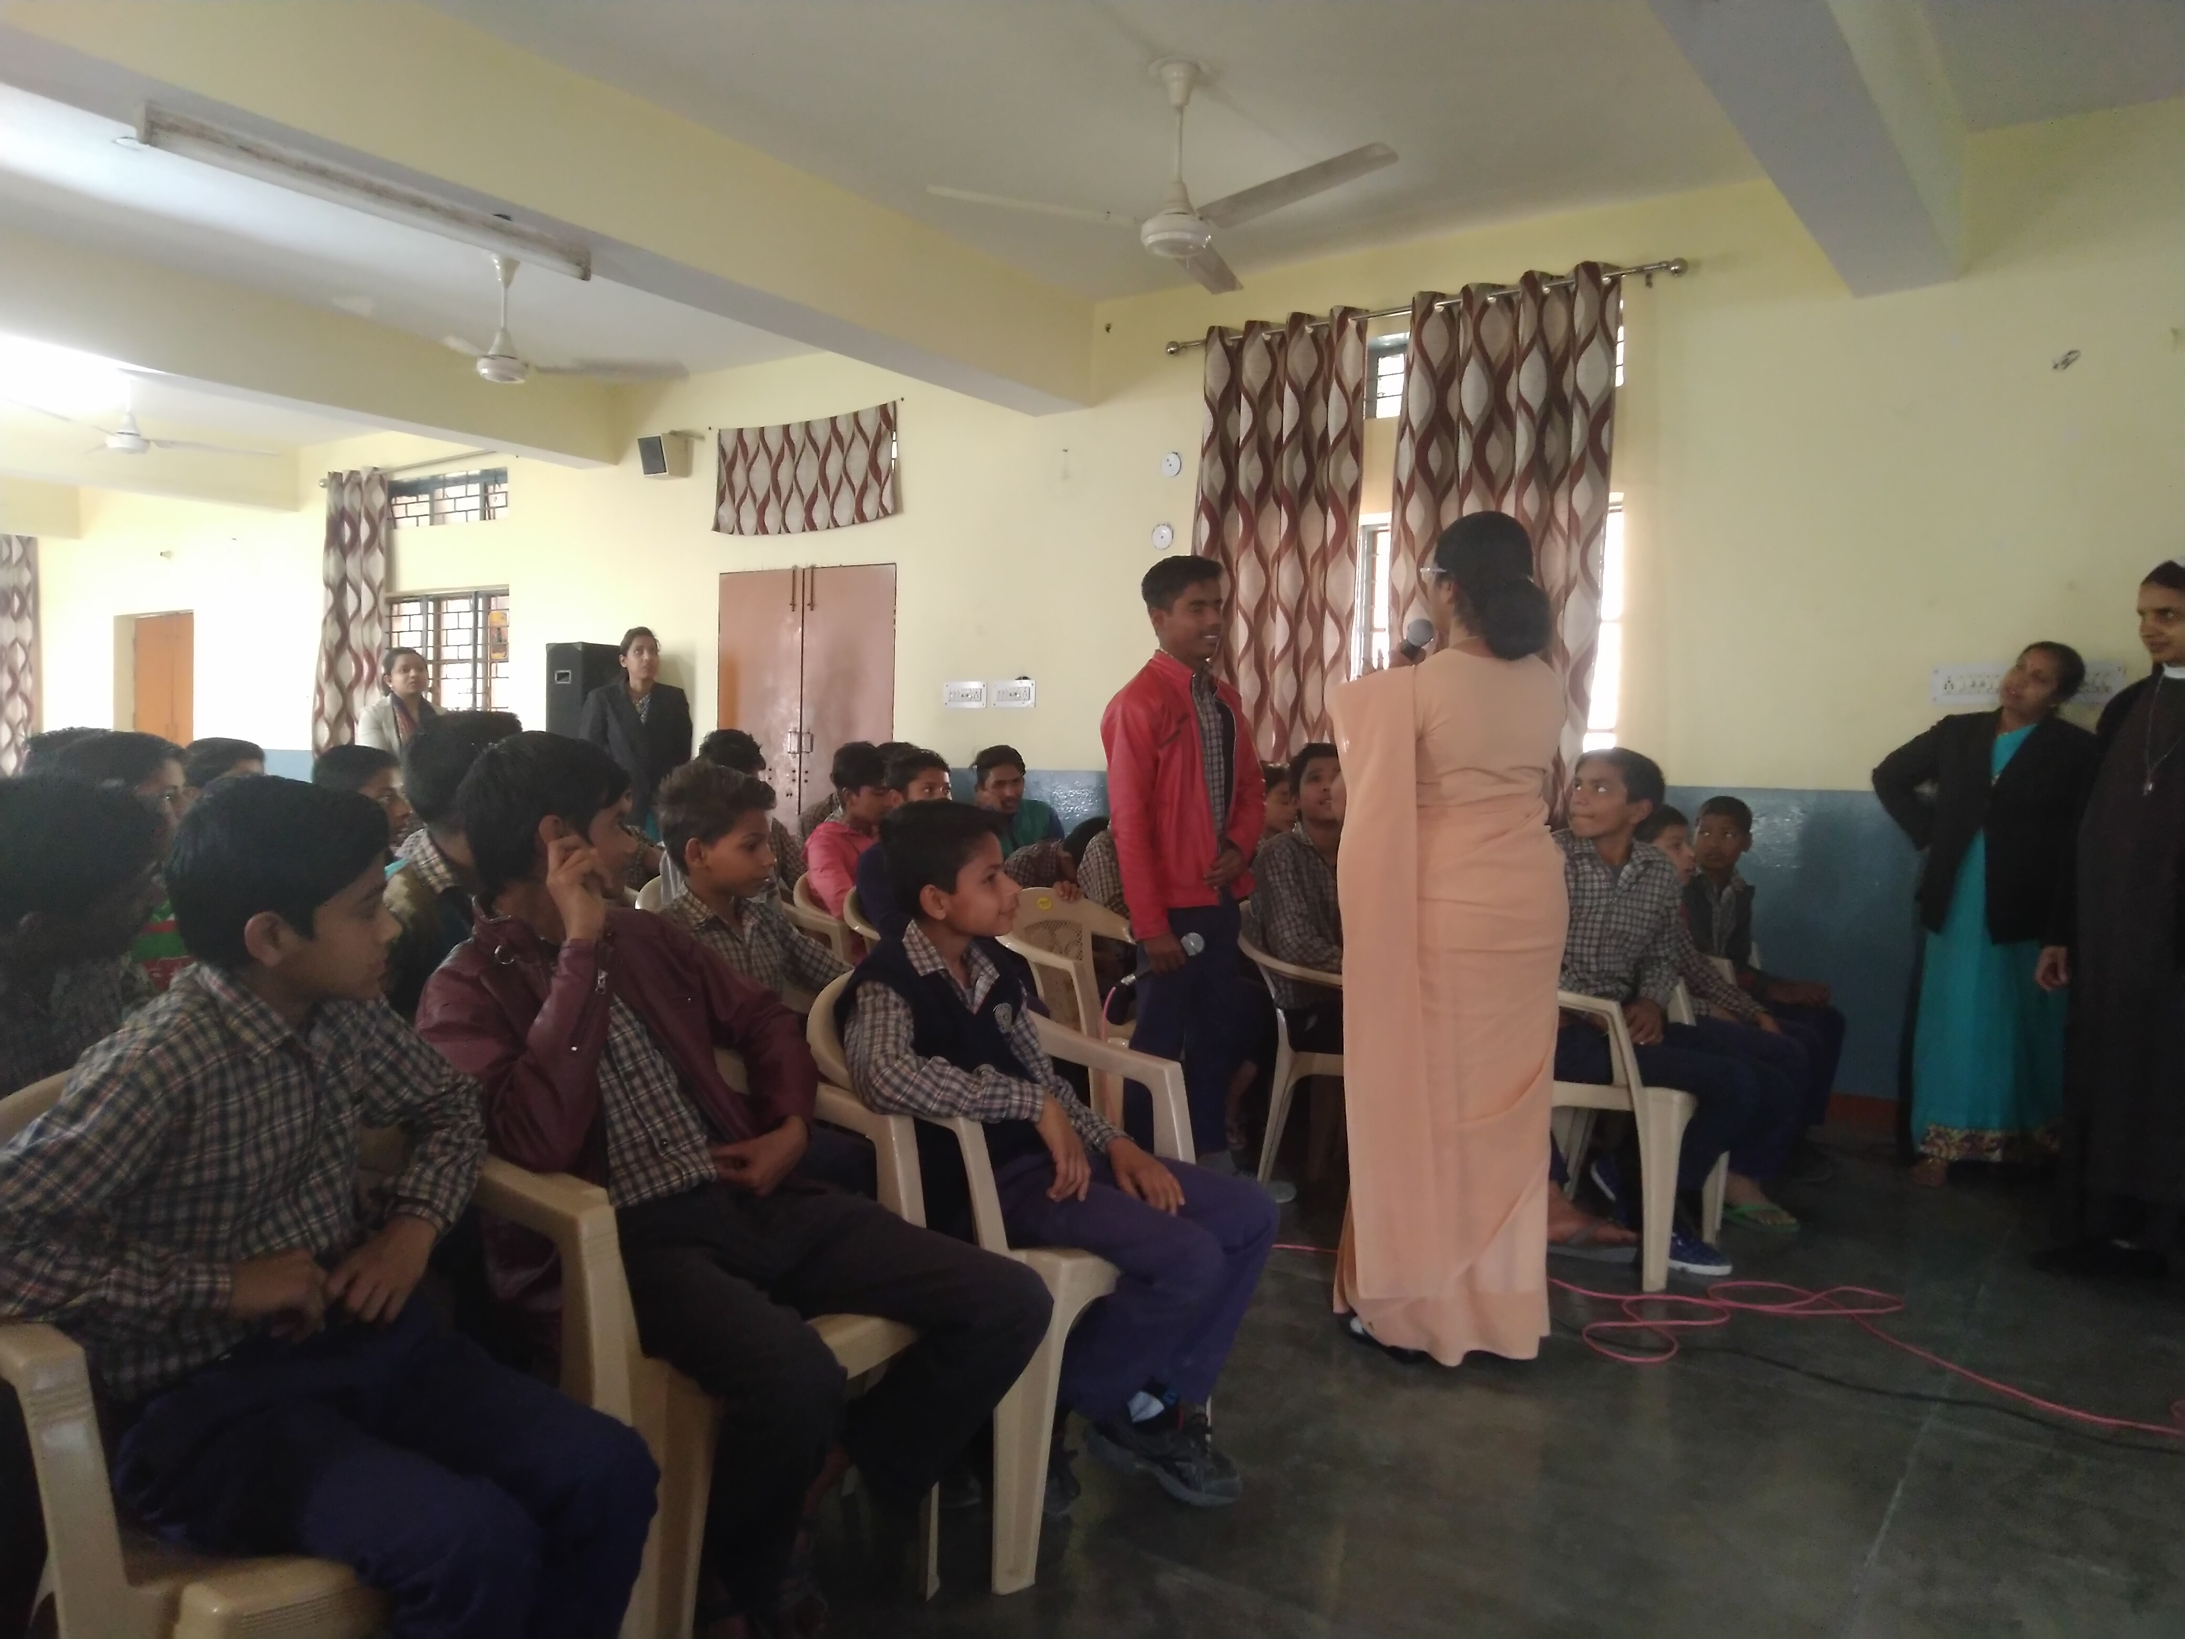
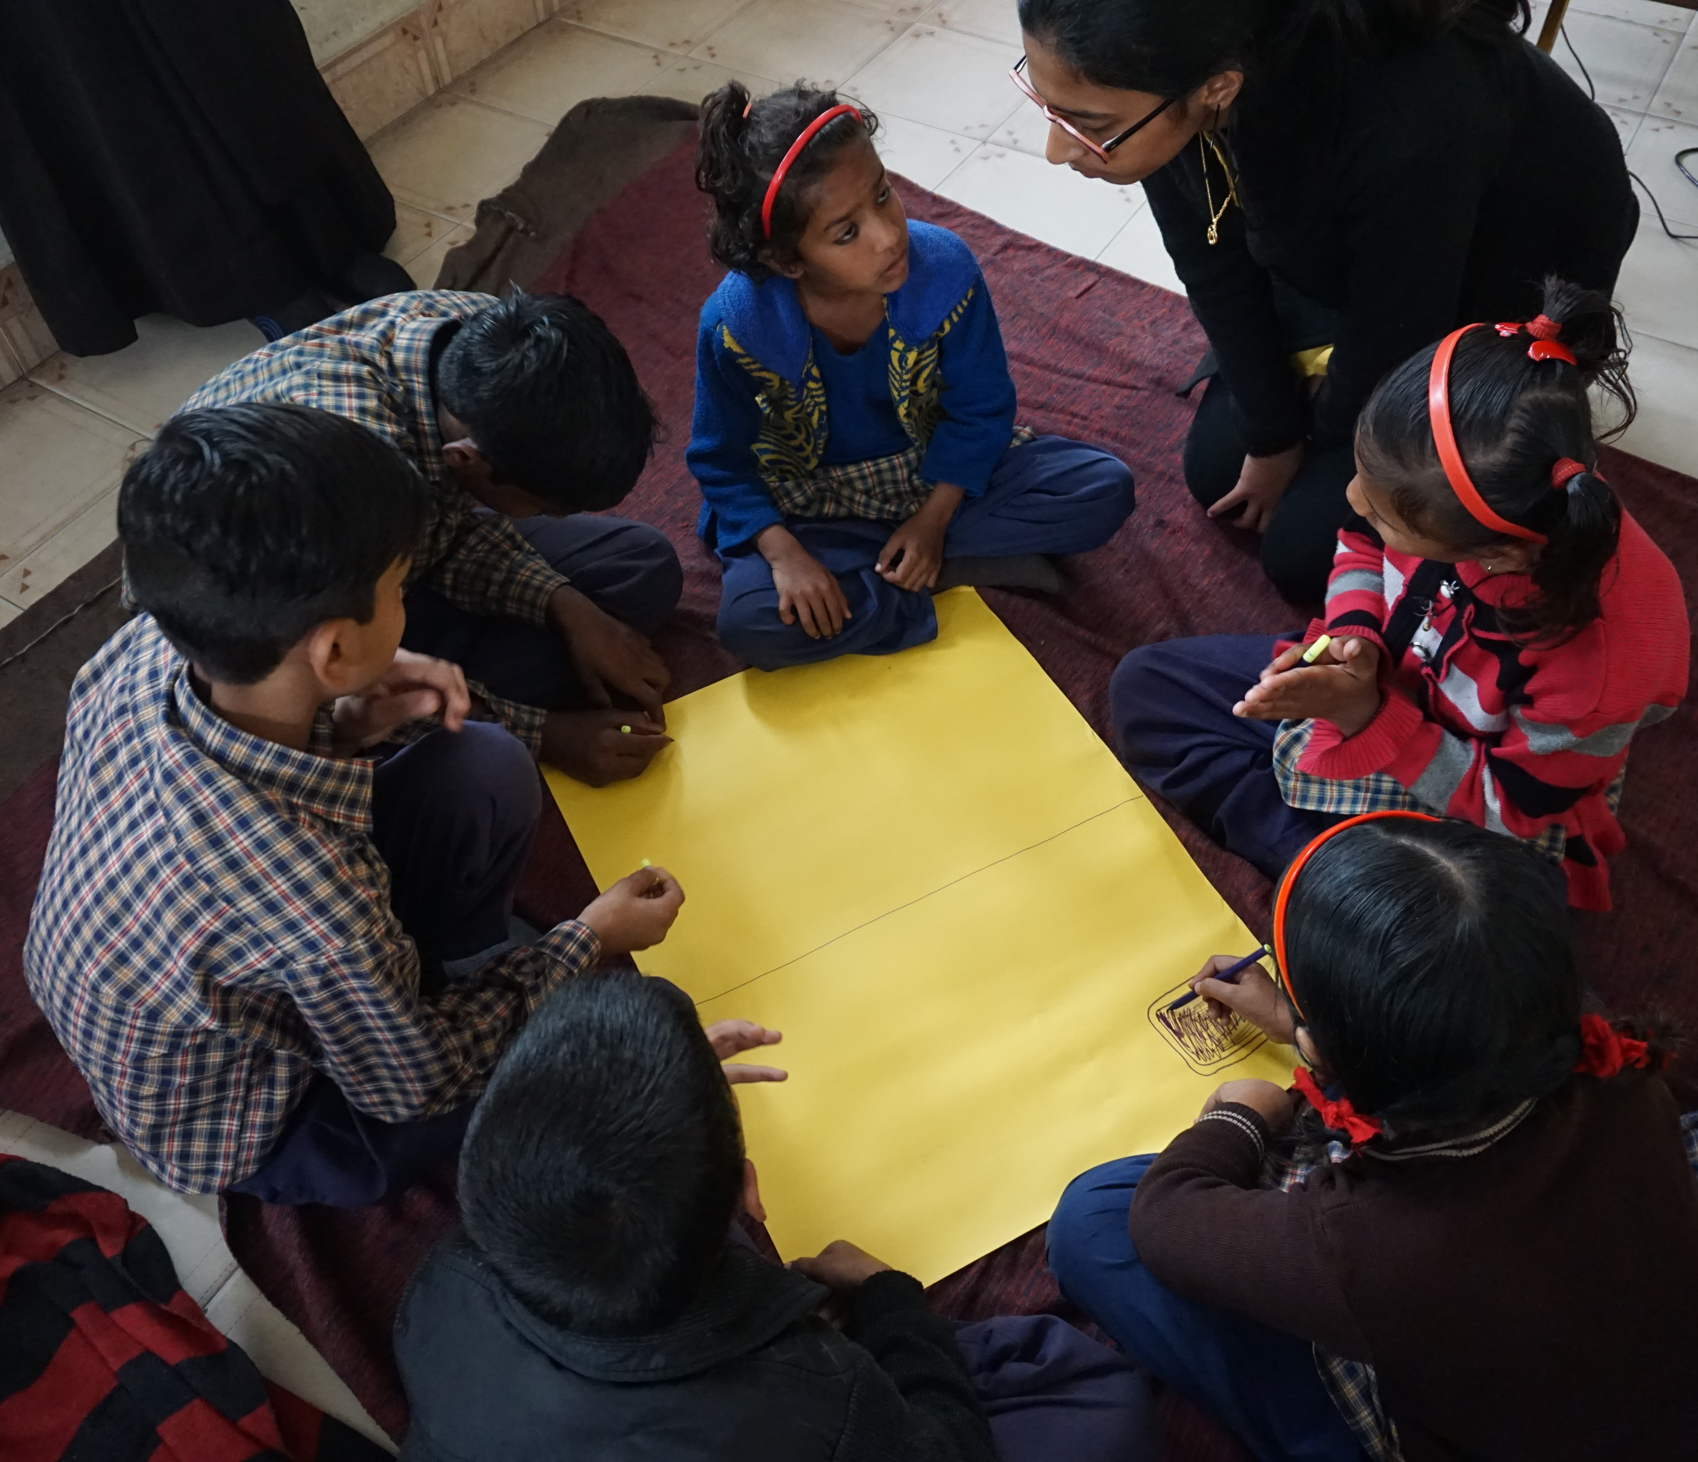
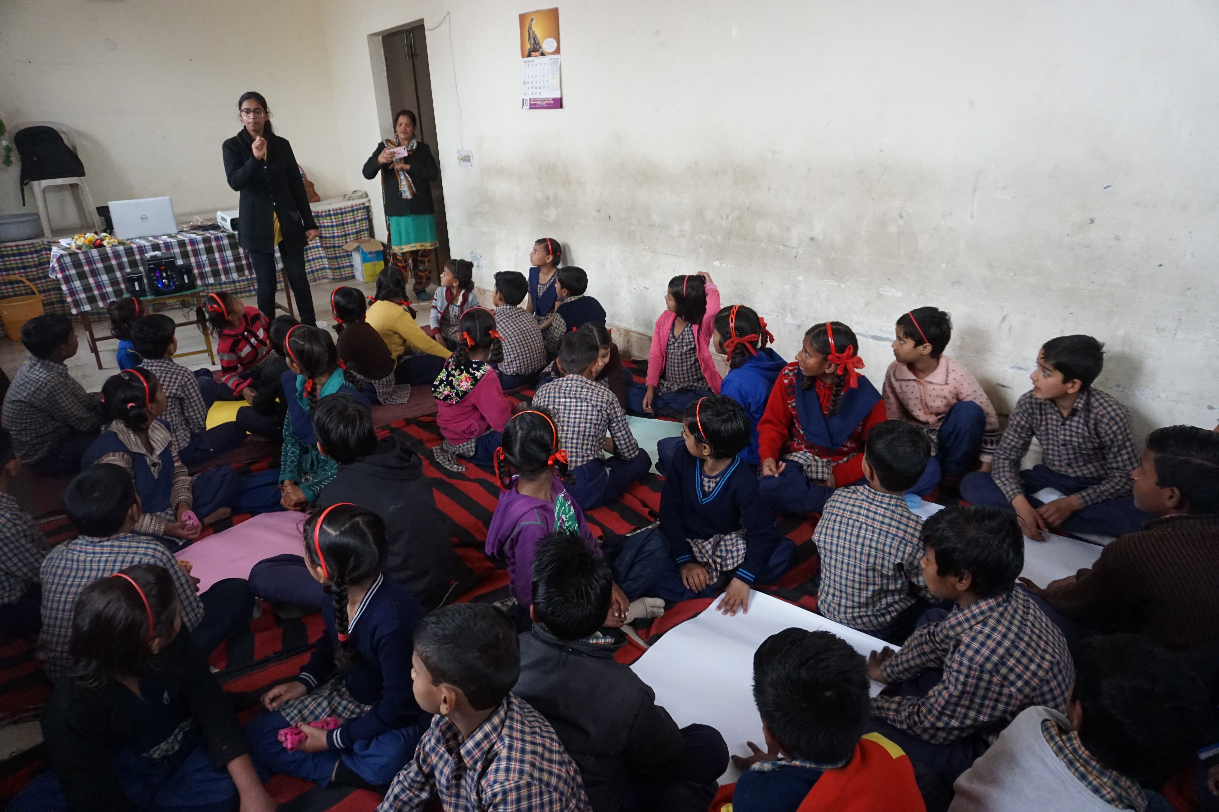
LEARNING BY DOING; LEARNING BY GAMING;LEARNING BY INTERACTING

Slide 35
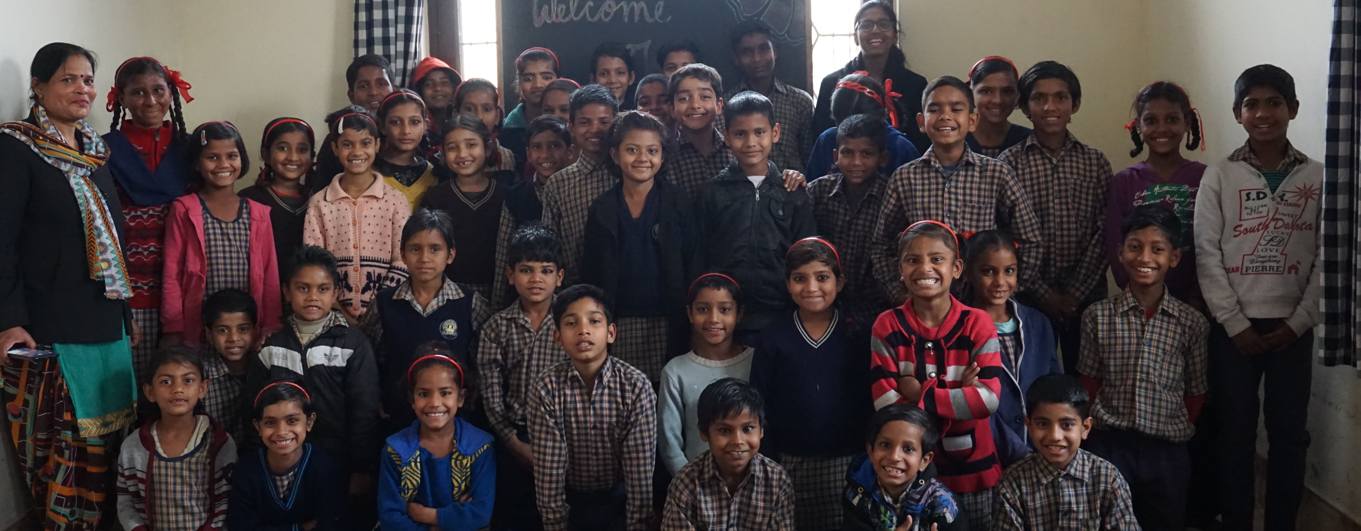
Army of knowledge
ARMY of SKILLS, with their WEAPON of smile and AWARENESS as the SHIELD!!

Slide 36
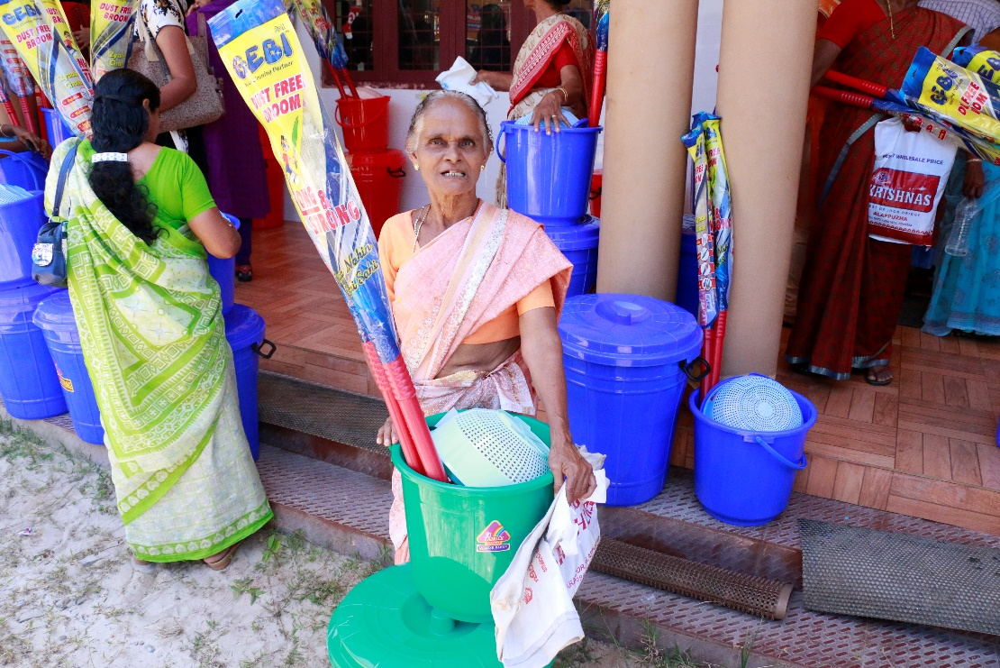
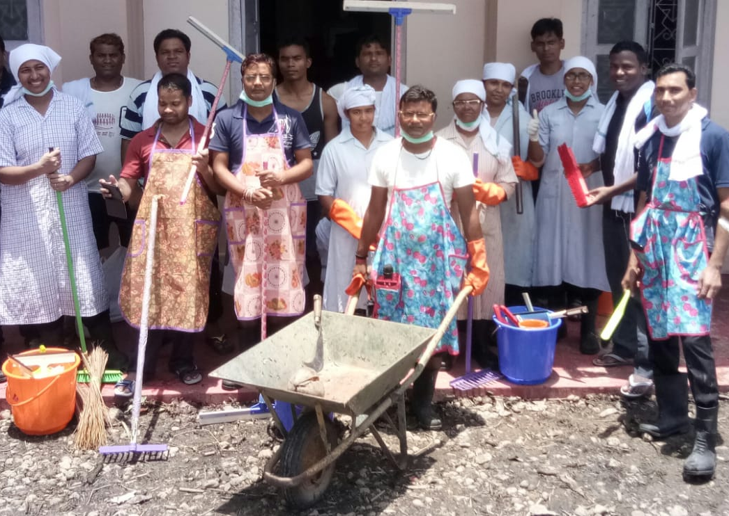
BREAD’s support to victims of Kerala deluge,2018

Slide 37
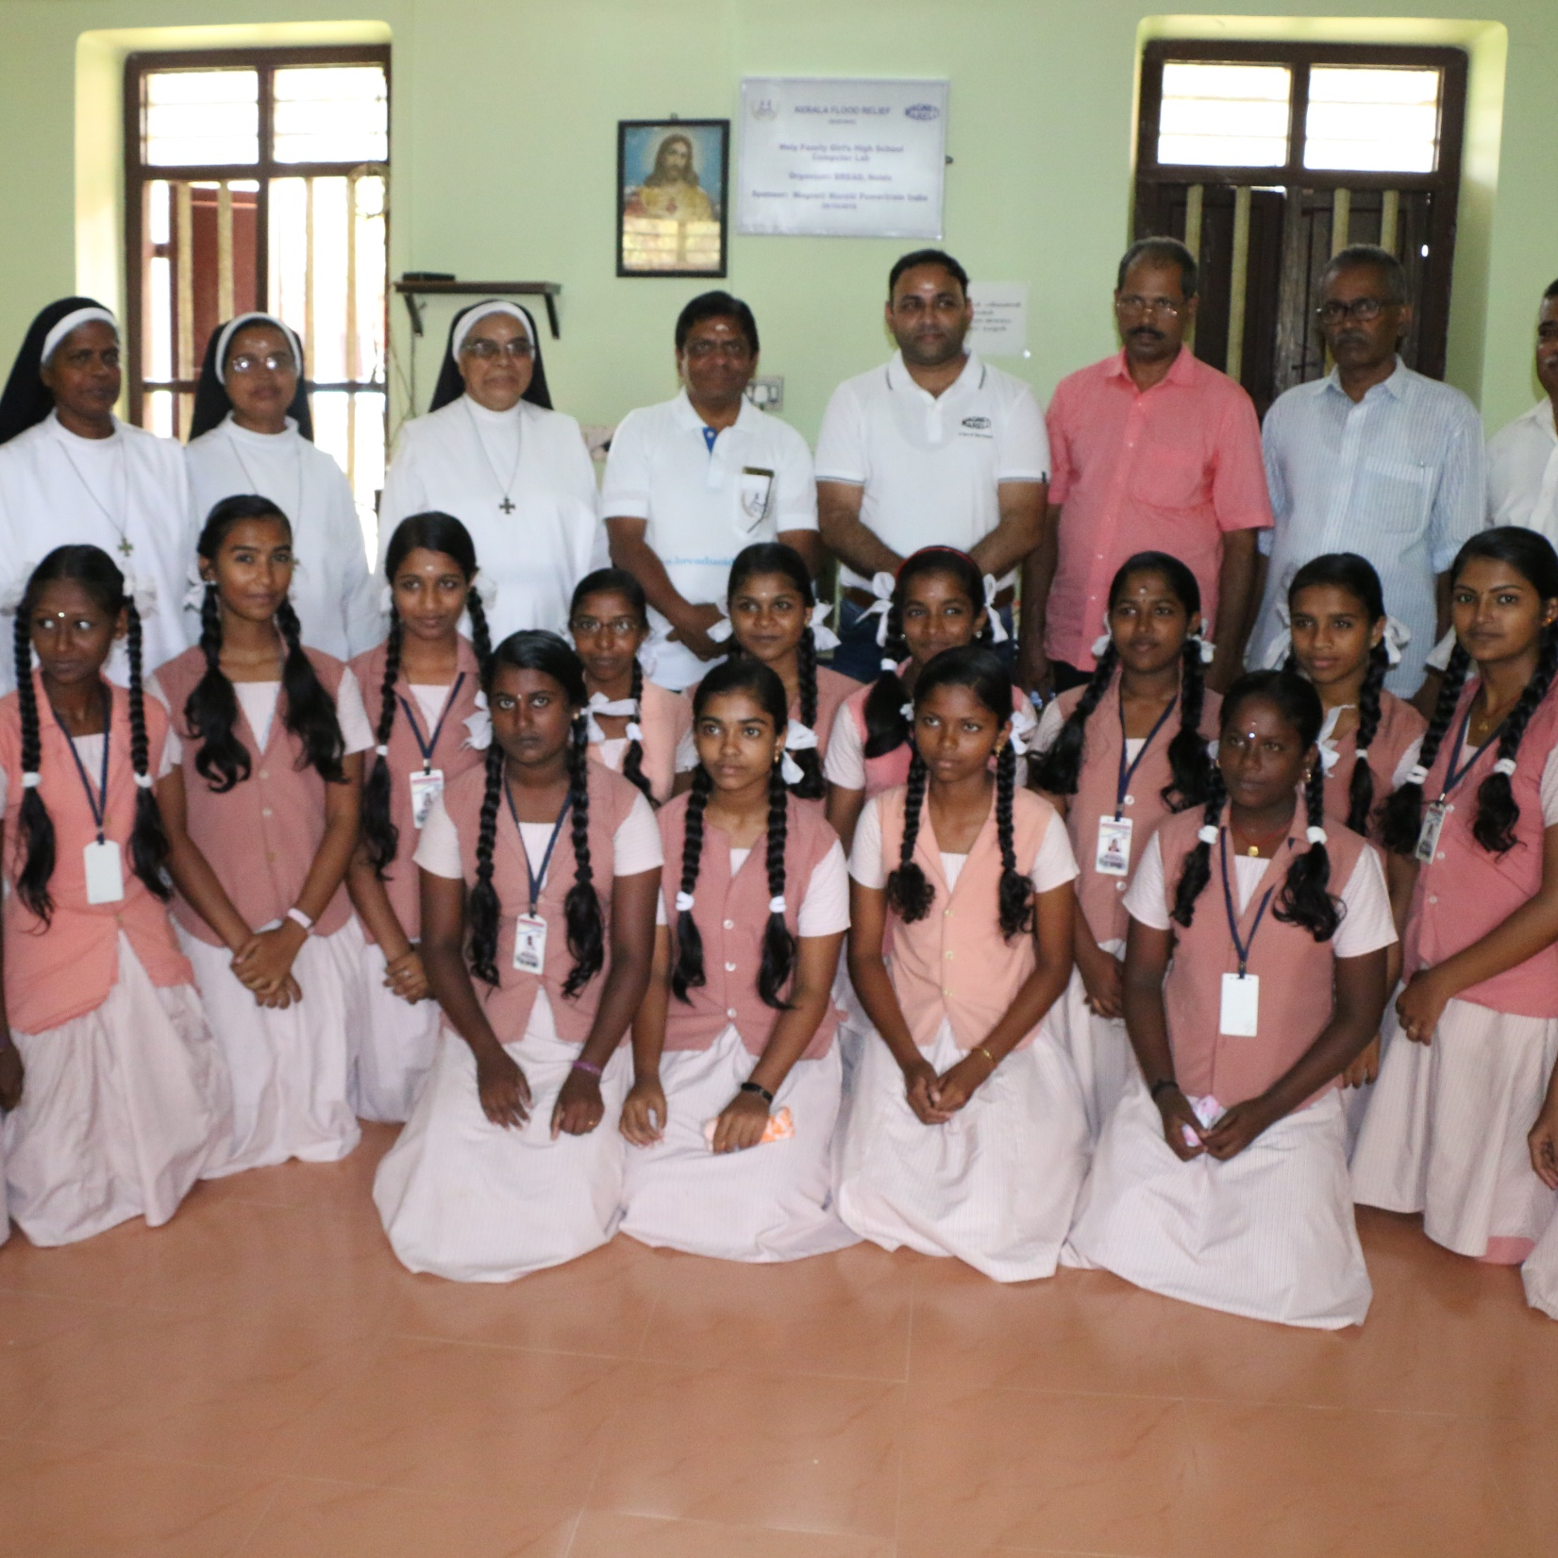
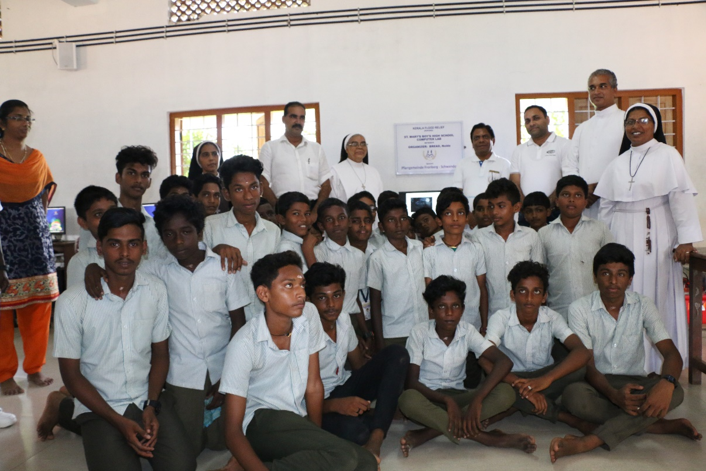
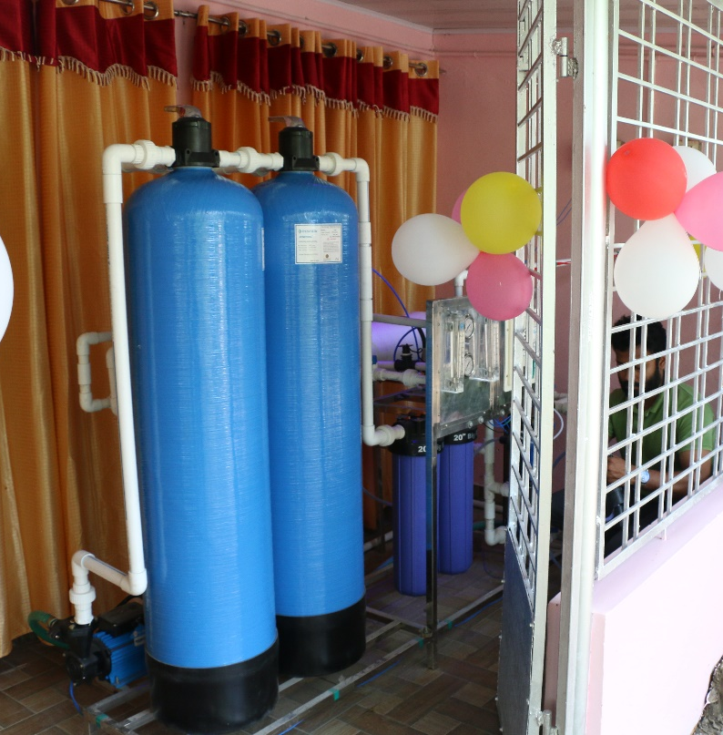
Renovated computer lab @St.Mary’s Boys High School and Holy family Girl’s High School
Installed RO plant in Kainakary,Alappuzha

Slide 38
Visit us:
www.breadnoida.org
www.facebook.com/marysmealsindia

Slide 39
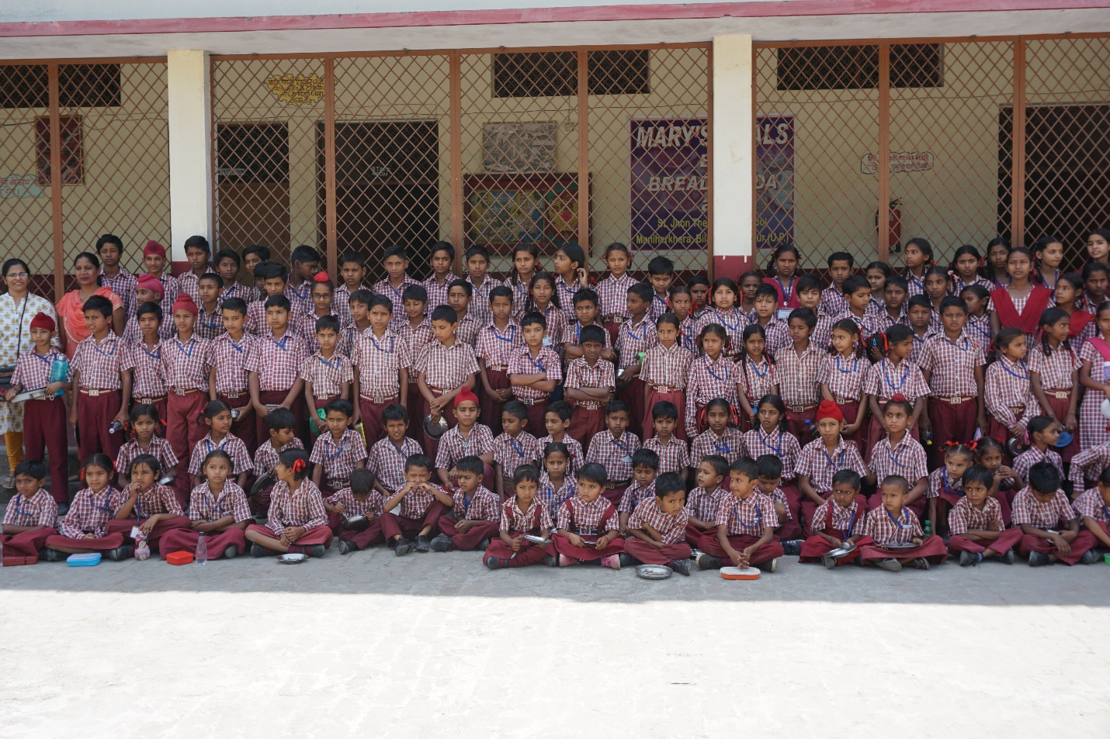
Thank You

